Slide 1


Modern C++ Course
Gammasoft

Slide 2

Who am I ?
Gammasoft
Gammasoft aims to make c++ fun again.
About
Gammasoft is the nickname of Yves Fiumefreddo.
More than thirty years of passion for high technology especially in development (c++, c#, objective-c, ...).
Object-oriented programming is more than a mindset.
more info see my GitHub : https://github.com/gammasoft71
Gammasoft
Modern C++ Course

Slide 3
Outline
Introduction
Language Basics
Object Oriented Programming (OOP)
Core Modern C++
Modern C++ Expert
Advanced Programming
Gammasoft
Modern C++ Course

Slide 4
Outline
Introduction
Language Basics
Object Oriented Programming (OOP)
Core Modern C++
Modern C++ Expert
Advanced Programming
Gammasoft
Modern C++ Course

Slide 5
Introduction
Introduction
What this course is?
History
Wy using C++?
References
C++ development tools
Gammasoft
Modern C++ Course

Slide 6
Introduction
Introduction
What this course is?
History
Wy using C++?
References
C++ development tools
Gammasoft
Modern C++ Course

Slide 7
What this course is?
Introduction | What this course is?
Gammasoft
Modern C++ Course

Slide 8
What this course is?
Introduction | What this course is?
Gammasoft
Modern C++ Course
This course aimed at inexperienced developers as well as experienced developers with no knowledge of Modern C++.

Slide 9
What this course is?
Introduction | What this course is?
Gammasoft
Modern C++ Course
This course aimed at inexperienced developers as well as experienced developers with no knowledge of Modern C++.
This course covers concepts from C++98 to C++23, while keeping modern C++ in mind.

Slide 10
What this course is?
Introduction | What this course is?
Gammasoft
Modern C++ Course
This course aimed at inexperienced developers as well as experienced developers with no knowledge of Modern C++.
This course covers concepts from C++98 to C++23, while keeping modern C++ in mind.
The corresponding C++ version is indicated for each concept and feature.
Notes:
Dans le coin supérieur gauche

Slide 11
Introduction
Introduction
What this course is?
History
Wy using C++?
References
C++ development tools
Gammasoft
Modern C++ Course

Slide 12
Introduction
Introduction
What this course is?
History
Wy using C++?
References
C++ development tools
Gammasoft
Modern C++ Course

Slide 13

Bjarne Stroupstrup
Introduction | History
Bjarne Stroustrup, a Danish computer scientist, is the creator of C++.
Gammasoft
Modern C++ Course

Slide 14
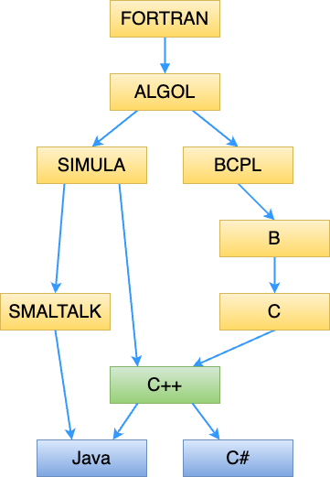
C++ language
Introduction | History
In 1979, Bjarne Stroustrup began work on "C with Classes", the predecessor to "C++".
In 1982, Stroustrup started to develop a successor to "C with Classes", which he named "C++".
In 1985, the first edition of The C++ Programming Language was released
In 1998, C++98 was released, standardizing the language
Gammasoft
Modern C++ Course
Notes:
1954 : FORTRAN 1972 : SMALTALK
1958 : ALGOL 1979 -> 1998 : C++
1967 : SIMULA / BCPL 1994 : Java
1969 : B 2002 : C#
1971 : C

Slide 15
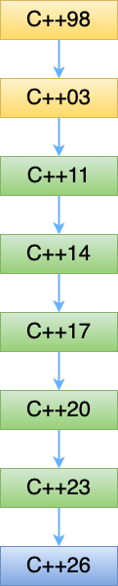
C++ Standards
Introduction | History
1998 | 14882:1998 | C++98
2003 | 14882:2003 | C++03
2011 | 14882:2011 | C++11
2014 | 14882:2014 | C++14
2017 | 14882:2017 | C++17
2020 | 14882:2020 | C++20
2024 | 14882:2024 | C++23
TBA | | C++26
Gammasoft
Modern C++ Course

Slide 16
Introduction
Introduction
What this course is?
History
Wy using C++?
References
C++ development tools
Gammasoft
Modern C++ Course

Slide 17
Introduction
Introduction
What this course is?
History
Wy using C++?
References
C++ development tools
Gammasoft
Modern C++ Course

Slide 18
Adapted to large projects
Introduction | Why using C++?
Gammasoft
Modern C++ Course

Slide 19
Adapted to large projects
Introduction | Why using C++?
Statically and strongly typed
Gammasoft
Modern C++ Course

Slide 20
Adapted to large projects
Introduction | Why using C++?
Statically and strongly typed
Object oriented
Gammasoft
Modern C++ Course

Slide 21
Adapted to large projects
Introduction | Why using C++?
Statically and strongly typed
Object oriented
Widely used (and taught)
Gammasoft
Modern C++ Course

Slide 22
Adapted to large projects
Introduction | Why using C++?
Statically and strongly typed
Object oriented
Widely used (and taught)
Many available libraries
Gammasoft
Modern C++ Course

Slide 23
Adapted to large projects
Introduction | Why using C++?
Statically and strongly typed
Object oriented
Widely used (and taught)
Many available libraries
Many available documentations and examples on the net
Gammasoft
Modern C++ Course

Slide 24
Fast
Introduction | Why using C++?
Gammasoft
Modern C++ Course

Slide 25
Fast
Introduction | Why using C++?
unlike some other languages (Java, C#, Python, ...) C++ is compiled to native machine code
Gammasoft
Modern C++ Course

Slide 26
Fast
Introduction | Why using C++?
unlike some other languages (Java, C#, Python, ...) C++ is compiled to native machine code
close to hardware when needed
Gammasoft
Modern C++ Course

Slide 27
What we get?
Introduction | Why using C++?
Gammasoft
Modern C++ Course

Slide 28
What we get?
Introduction | Why using C++?
The most powerful language
Gammasoft
Modern C++ Course

Slide 29
What we get?
Introduction | Why using C++?
The most powerful language
The most complicated one
Gammasoft
Modern C++ Course

Slide 30
What we get?
Introduction | Why using C++?
The most powerful language
The most complicated one
The most error prone?
Gammasoft
Modern C++ Course

Slide 31
Introduction
Introduction
What this course is?
History
Wy using C++?
References
C++ development tools
Gammasoft
Modern C++ Course

Slide 32
Introduction
Introduction
What this course is?
History
Wy using C++?
References
C++ development tools
Gammasoft
Modern C++ Course

Slide 33
Books
Introduction | References
Gammasoft
Modern C++ Course

Slide 34
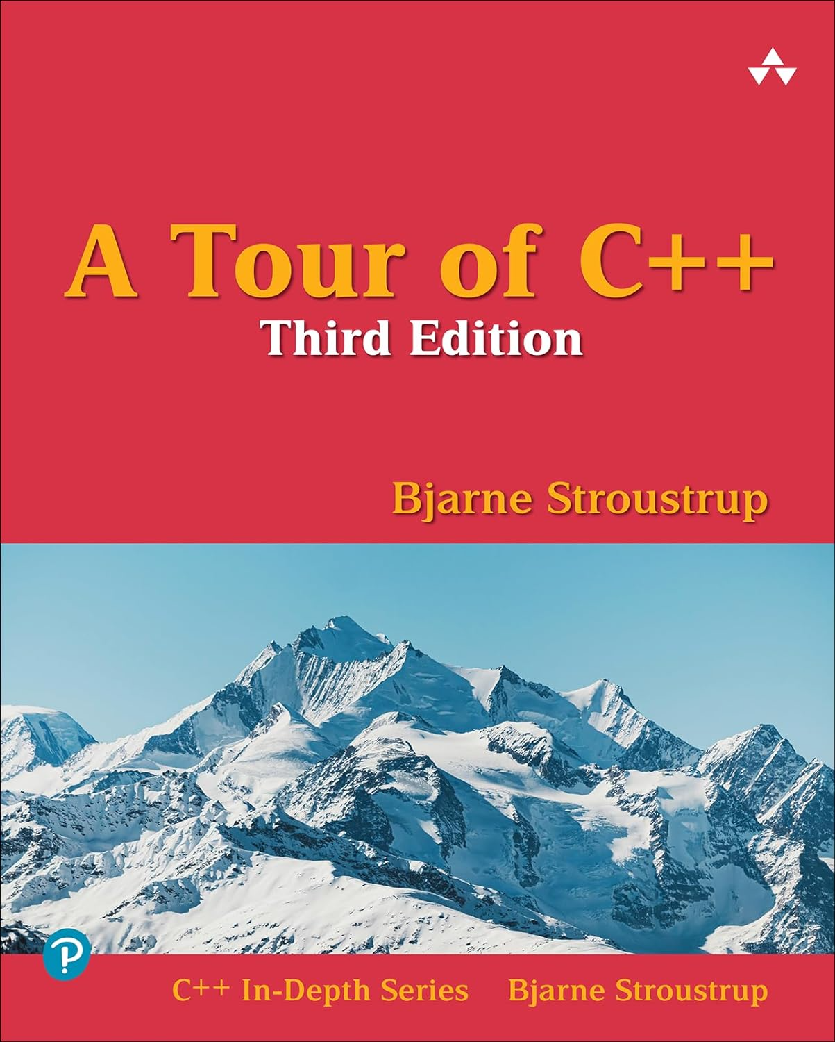
Books
Introduction | References
Gammasoft
Modern C++ Course

Slide 35
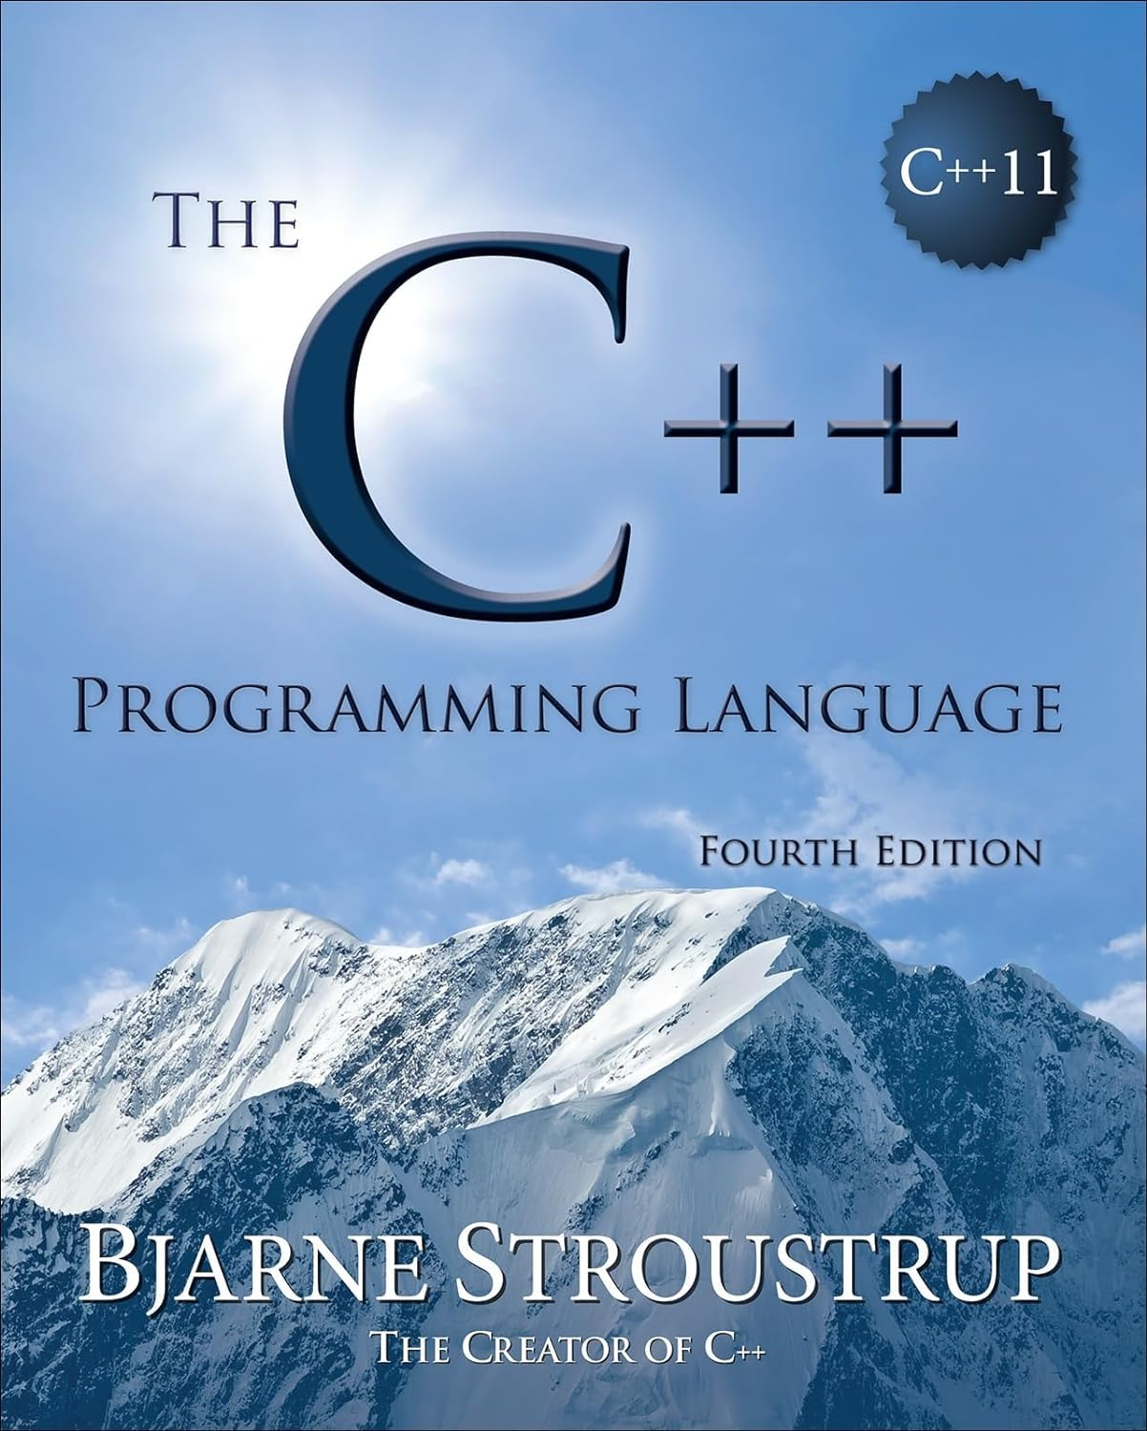
Books
Introduction | References
Gammasoft
Modern C++ Course

Slide 36
Useful links
Introduction | References
Gammasoft
Modern C++ Course

Slide 37
Useful links
Introduction | References
https://isocpp.org
Gammasoft
Modern C++ Course

Slide 38
Useful links
Introduction | References
https://isocpp.org
https://cppreference.com
Gammasoft
Modern C++ Course

Slide 39
Useful links
Introduction | References
https://isocpp.org
https://cppreference.com
https://github.com
Gammasoft
Modern C++ Course

Slide 40
Useful links
Introduction | References
https://isocpp.org
https://cppreference.com
https://github.com
https://stackoverflow.com
Gammasoft
Modern C++ Course

Slide 41
Useful links
Introduction | References
https://isocpp.org
https://cppreference.com
https://github.com
https://stackoverflow.com
https://www.programmingalgorithms.com
Gammasoft
Modern C++ Course

Slide 42
Useful links
Introduction | References
https://isocpp.org
https://cppreference.com
https://github.com
https://stackoverflow.com
https://www.programmingalgorithms.com
And more...
Gammasoft
Modern C++ Course

Slide 43
Introduction
Introduction
What this course is?
History
Wy using C++?
References
C++ development tools
Gammasoft
Modern C++ Course

Slide 44
Introduction
Introduction
What this course is?
History
Wy using C++?
References
C++ development tools
Gammasoft
Modern C++ Course

Slide 45
Compilers
Introduction | C++ development tools
C++ | GCC | Clang | MSVC | Apple Clang
11 | >= 4.8 | >= 3.3 | >= 19 | >= 3.3
14 | >= 4.9 | >= 3.4 | >= 19 | >= 3.3
17 | >= 7.3 | >= 5 | >= 19.01 | >= 10
20 | >= 11 | >= 19 | >= 19.29 | >= 15
23 | >= 15 | >= 19 | >= 19.40 | >= 15
Gammasoft
Modern C++ Course

Slide 46

CMake
Introduction | C++ development tools
Gammasoft
Modern C++ Course

Slide 47
CMake
Introduction | C++ development tools
Single source builds on multiple platforms
Gammasoft
Modern C++ Course

Slide 48
CMake
Introduction | C++ development tools
Single source builds on multiple platforms
Accurate dependencies and minimal rebuilds
Gammasoft
Modern C++ Course

Slide 49
CMake
Introduction | C++ development tools
Single source builds on multiple platforms
Accurate dependencies and minimal rebuilds
Out-of-source builds
Gammasoft
Modern C++ Course

Slide 50
CMake
Introduction | C++ development tools
Single source builds on multiple platforms
Accurate dependencies and minimal rebuilds
Out-of-source builds
Cross-platform packaging system
Gammasoft
Modern C++ Course

Slide 51
CMake
Introduction | C++ development tools
Single source builds on multiple platforms
Accurate dependencies and minimal rebuilds
Out-of-source builds
Cross-platform packaging system
Cross-platform testing system
Gammasoft
Modern C++ Course

Slide 52
CMake
Introduction | C++ development tools
Single source builds on multiple platforms
Accurate dependencies and minimal rebuilds
Out-of-source builds
Cross-platform packaging system
Cross-platform testing system
And more...
Gammasoft
Modern C++ Course

Slide 53
Integrated Development Environment (IDE)
Introduction | C++ development tools
Gammasoft
Modern C++ Course

Slide 54

Integrated Development Environment (IDE)
Introduction | C++ development tools
Microsoft Visual Studio (Windows)
Gammasoft
Modern C++ Course

Slide 55

Integrated Development Environment (IDE)
Introduction | C++ development tools
Microsoft Visual Studio (Windows)
Xcode (macOS)
Gammasoft
Modern C++ Course

Slide 56

Integrated Development Environment (IDE)
Introduction | C++ development tools
Microsoft Visual Studio (Windows)
Xcode (macOS)
Microsoft Visual Studio Code (Windows, macOS and Linux)
Gammasoft
Modern C++ Course

Slide 57







Integrated Development Environment (IDE)
Introduction | C++ development tools
Microsoft Visual Studio (Windows)
Xcode (macOS)
Microsoft Visual Studio Code (Windows, macOS and Linux)
and others
Gammasoft
Modern C++ Course

Slide 58

Configure your development environment
Introduction | C++ development tools
Gammasoft
Modern C++ Course

Slide 59
Configure your development environment
Introduction | C++ development tools
Install compiler
Gammasoft
Modern C++ Course

Slide 60
Configure your development environment
Introduction | C++ development tools
Install compiler
Install IDE (according to OS)
Gammasoft
Modern C++ Course

Slide 61
Configure your development environment
Introduction | C++ development tools
Install compiler
Install IDE (according to OS)
Install CMake
Gammasoft
Modern C++ Course

Slide 62
Configure your development environment
Introduction | C++ development tools
Install compiler
Install IDE (according to OS)
Install CMake
Install SCM like git (not mandatory)
Gammasoft
Modern C++ Course

Slide 63
Configure your development environment
Introduction | C++ development tools
Install compiler
Install IDE (according to OS)
Install CMake
Install SCM like git (not mandatory)
Subscribe to GitHub (not mandatory)
Gammasoft
Modern C++ Course

Slide 64
Introduction
Introduction
What this course is?
History
Wy using C++?
References
C++ development tools
Gammasoft
Modern C++ Course

Slide 65
Introduction
Introduction
What this course is?
History
Wy using C++?
References
C++ development tools
Gammasoft
Modern C++ Course

Slide 66
Outline
Introduction
Language Basics
Object Oriented Programming (OOP)
Core Modern C++
Modern C++ Expert
Advanced Programming
Gammasoft
Modern C++ Course

Slide 67
Outline
Introduction
Language Basics
Object Oriented Programming (OOP)
Core Modern C++
Modern C++ Expert
Advanced Programming
Gammasoft
Modern C++ Course

Slide 68
Language Basics
Language Basics
Gammasoft
Modern C++ Course
Hello World
Core syntax and types
Arrays and Pointers
Scopes / namespaces
Struct and enum types
References
Functions
Operators
Control structures
Headers and interfaces
auto keyword
inline keyword
Assertions

Slide 69
Language Basics
Language Basics
Gammasoft
Modern C++ Course
Hello World
Core syntax and types
Arrays and Pointers
Scopes / namespaces
Struct and enum types
References
Functions
Operators
Control structures
Headers and interfaces
auto keyword
inline keyword
Assertions

Slide 70
The first classic application
C++98
Language Basics | Hello World
Gammasoft
Modern C++ Course

Slide 71
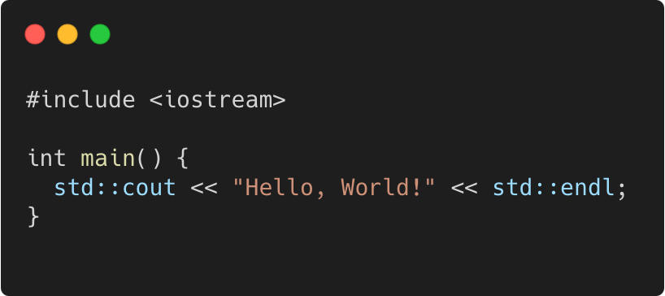
The first classic application
C++98
Language Basics | Hello World
program.cpp
Gammasoft
Modern C++ Course

Slide 72
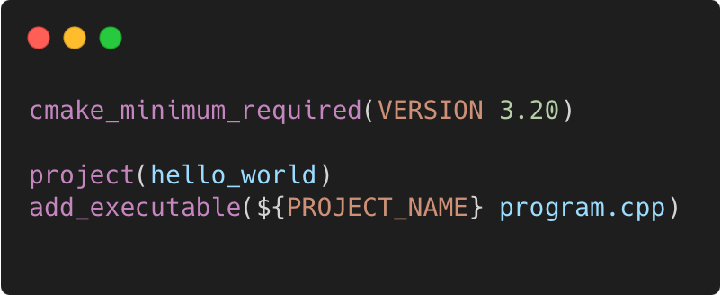
The first classic application
C++98
Language Basics | Hello World
program.cpp
CMakeLists.txt
Gammasoft
Modern C++ Course

Slide 73
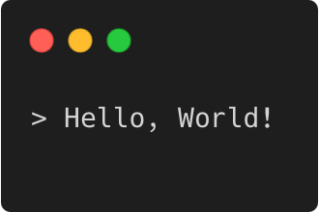
The first classic application
C++98
Language Basics | Hello World
program.cpp
CMakeLists.txt
Output
Gammasoft
Modern C++ Course

Slide 74
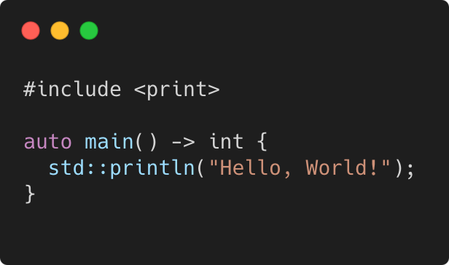
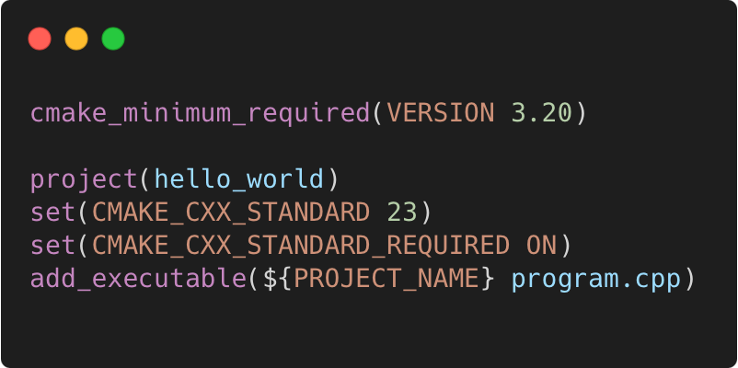
The first classic application
C++23
Language Basics | Hello World
program.cpp
CMakeLists.txt
Output
Gammasoft
Modern C++ Course

Slide 75
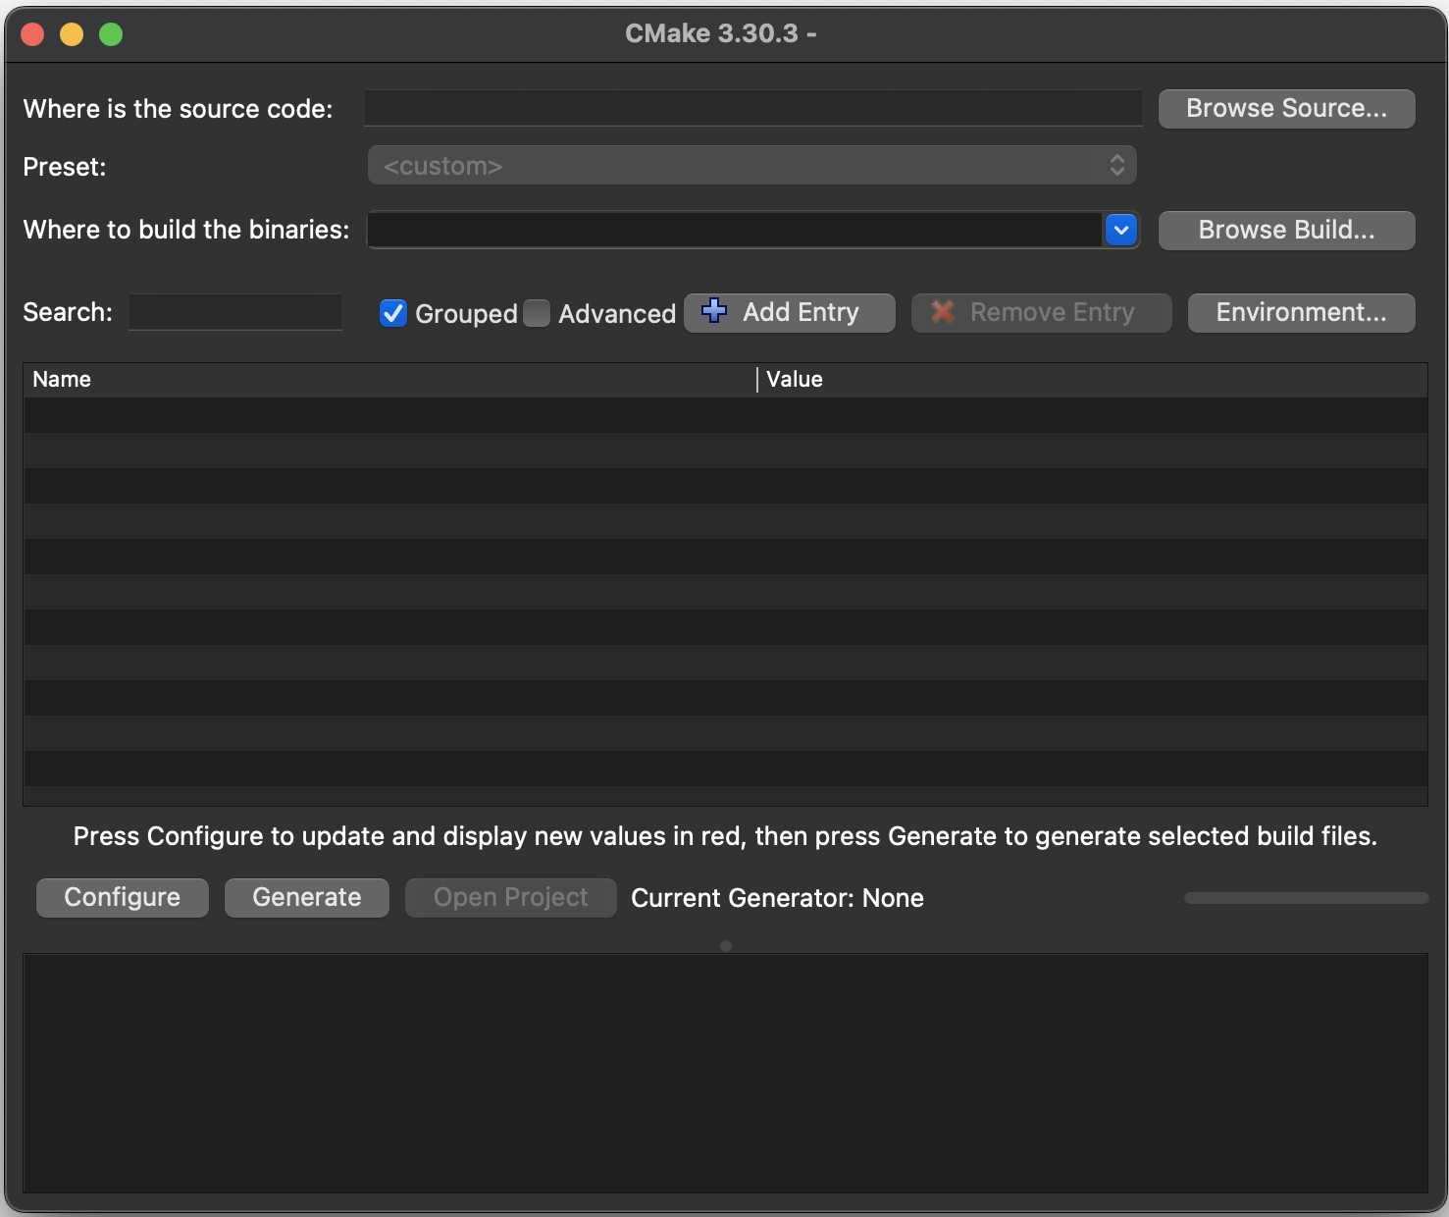
Execute with CMake GUI
Language Basics | Hello World
Open the CMake GUI application
Click on "Browse Sources..." button and select the "Hello world" folder.
Copy the path from "Where is the source code:", past it in the "Where to build the binaries:" and add "/build".
Click on "Configure" button and select the generator.
Click on "Generate" button to generate the project.
Finally, click on “Open project” button.
Gammasoft
Modern C++ Course

Slide 76
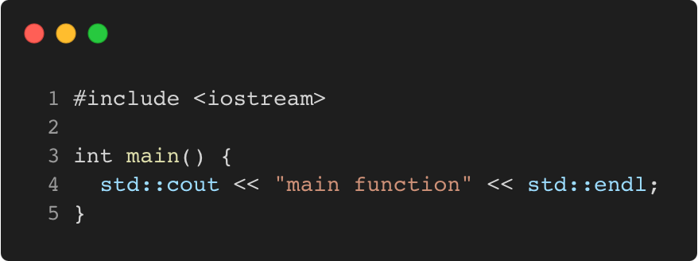
Main function
C++98
Language Basics | Hello World
Gammasoft
Modern C++ Course

Slide 77
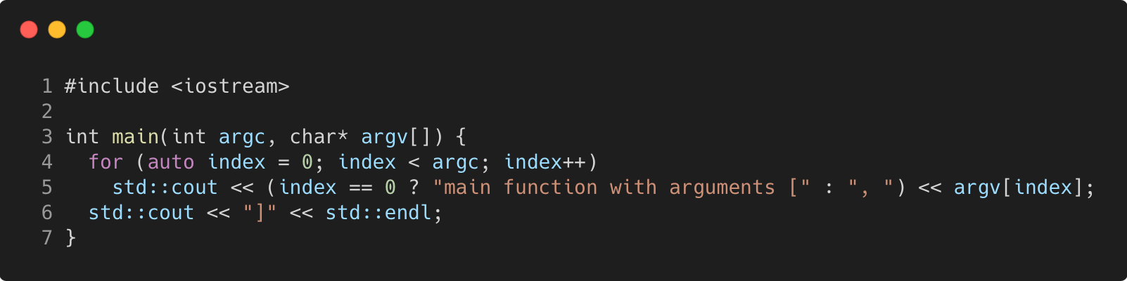
Main function
C++98
Language Basics | Hello World
Gammasoft
Modern C++ Course

Slide 78
Exercise : environment
Language Basics | Hello World
Learn how to use CMake to generate a project.
Go to exercises/environment
Look at environment.cpp and CMakeLists.txt
Compile it (make) and run the program (./environment)
Work on the tasks that you find in environment.cpp
Gammasoft
Modern C++ Course

Slide 79
Language Basics
Language Basics
Gammasoft
Modern C++ Course
Hello World
Core syntax and types
Arrays and Pointers
Scopes / namespaces
Struct and enum types
References
Functions
Operators
Control structures
Headers and interfaces
auto keyword
inline keyword
Assertions

Slide 80
Language Basics
Language Basics
Gammasoft
Modern C++ Course
Hello World
Core syntax and types
Arrays and Pointers
Scopes / namespaces
Struct and enum types
References
Functions
Operators
Control structures
Headers and interfaces
auto keyword
inline keyword
Assertions

Slide 81
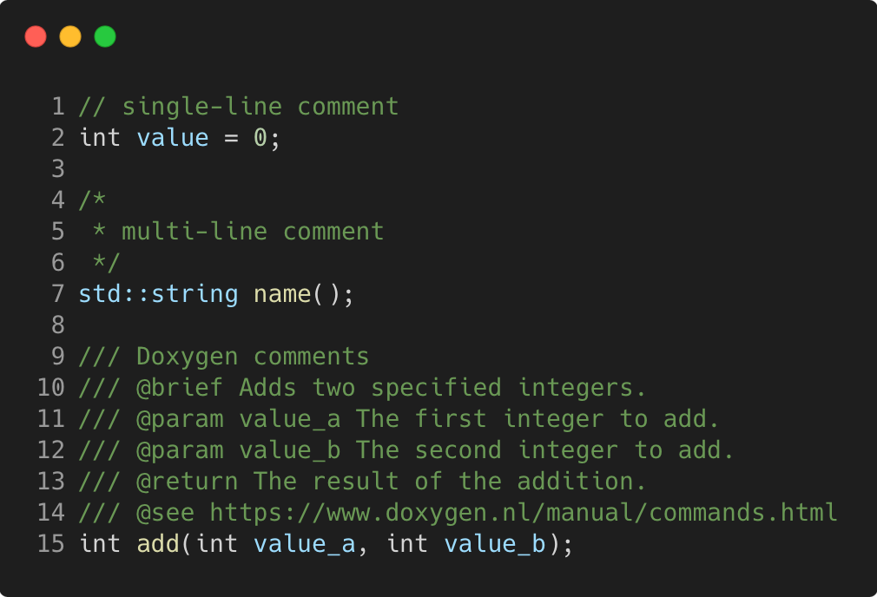
Comments
C++98
Language Basics | Core syntax and types
Gammasoft
Modern C++ Course

Slide 82
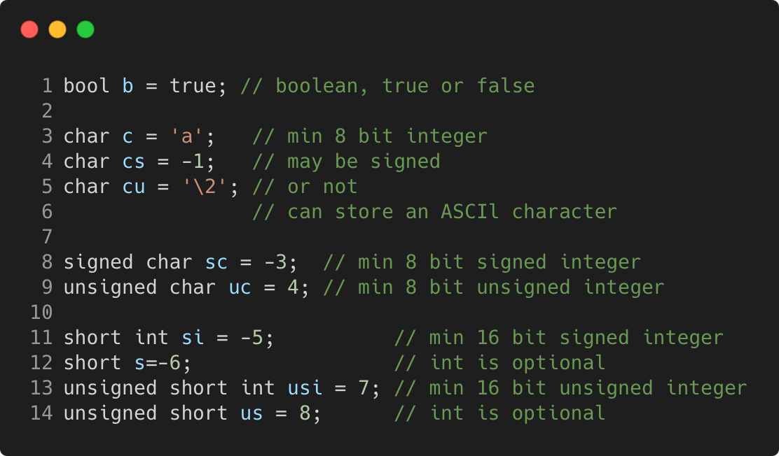
Basic types
C++98
Language Basics | Core syntax and types
Gammasoft
Modern C++ Course

Slide 83
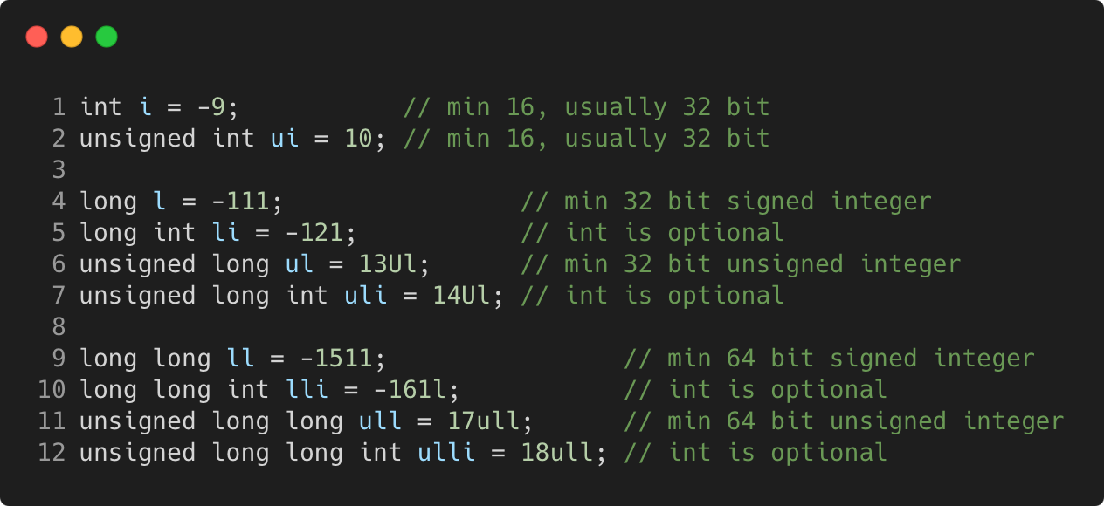
Basic types
C++98
Language Basics | Core syntax and types
Gammasoft
Modern C++ Course

Slide 84
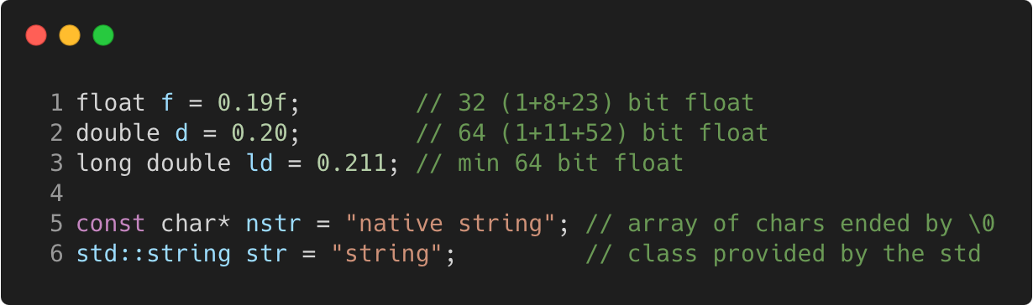
Basic types
C++98
Language Basics | Core syntax and types
Gammasoft
Modern C++ Course

Slide 85
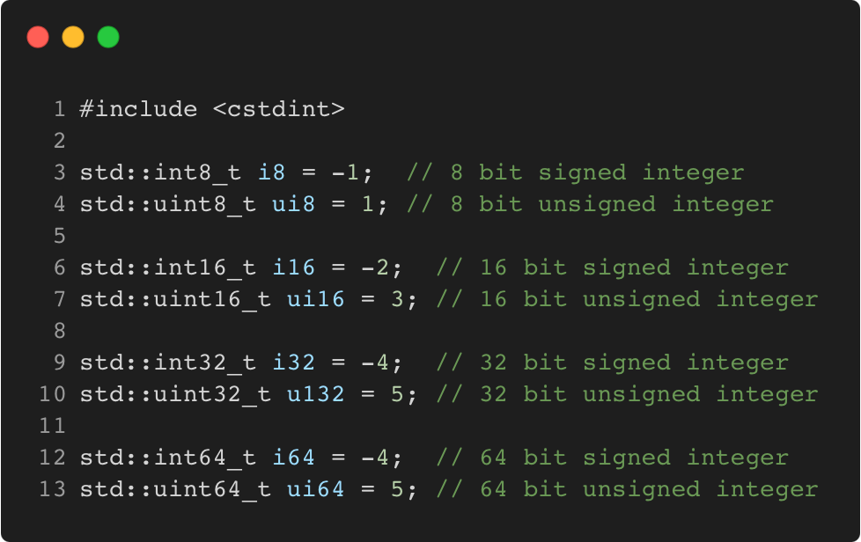
Fixed width integer types
C++11
Language Basics | Core syntax and types
Gammasoft
Modern C++ Course

Slide 86
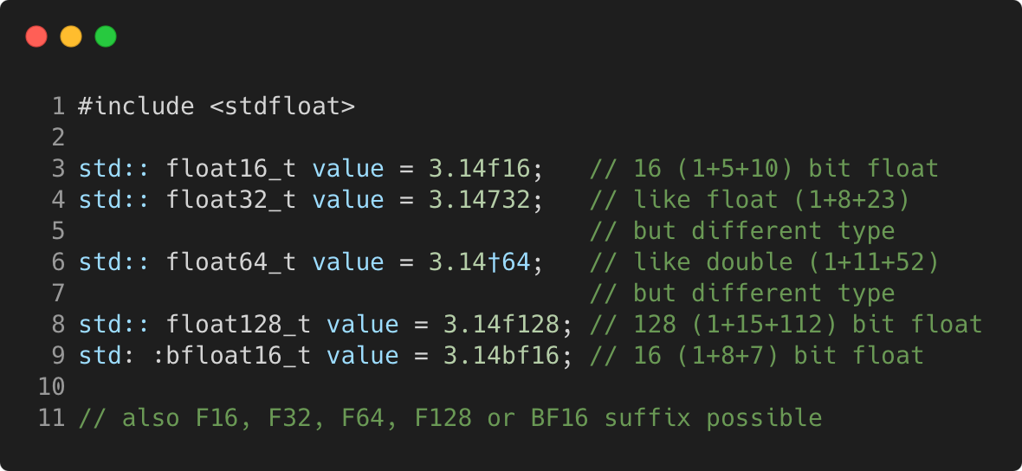
Fixed width floating-point types
C++23
Language Basics | Core syntax and types
Gammasoft
Modern C++ Course

Slide 87
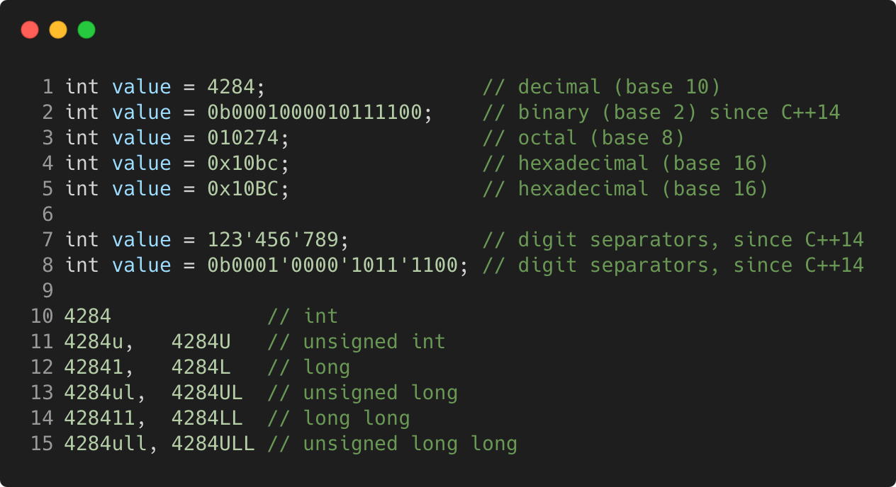
Integer literals
C++98
Language Basics | Core syntax and types
Gammasoft
Modern C++ Course

Slide 88
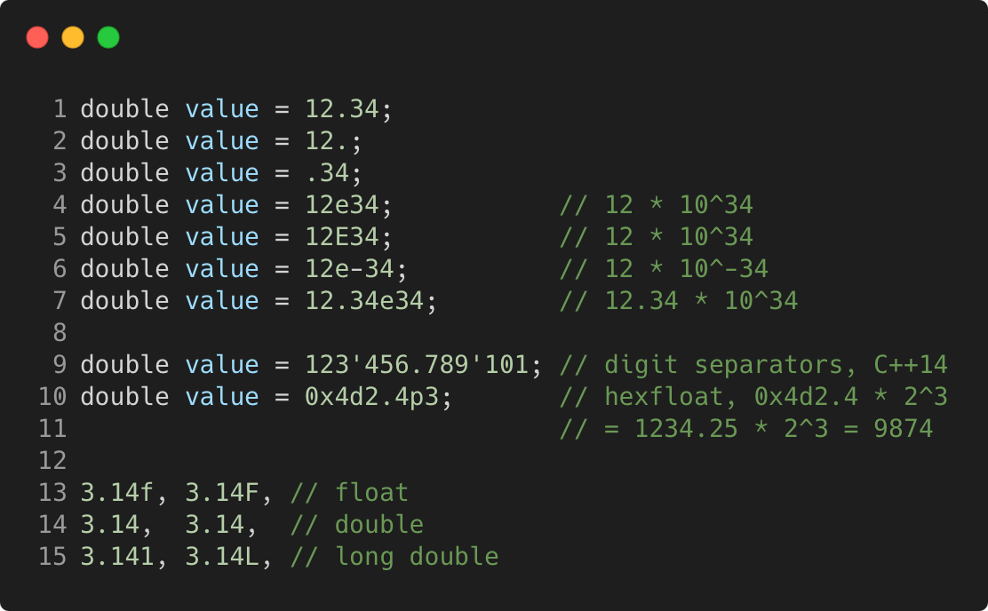
Floating-point literals
C++98
Language Basics | Core syntax and types
Gammasoft
Modern C++ Course

Slide 89
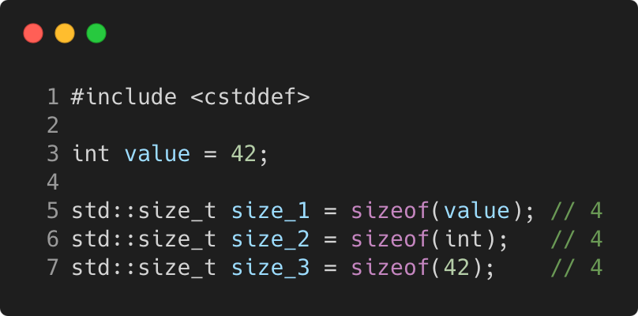
Sizeof
C++98
Language Basics | Core syntax and types
Gammasoft
Modern C++ Course

Slide 90
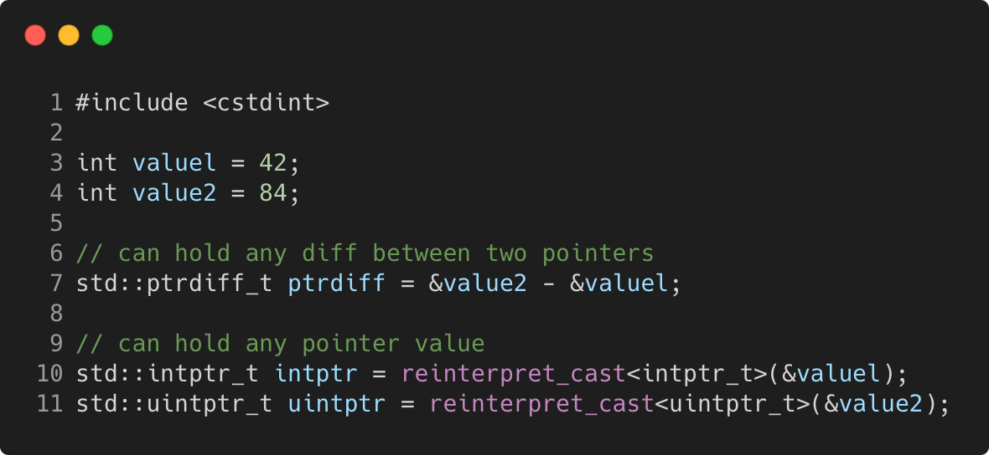
Pointer to integer
C++11
Language Basics | Core syntax and types
Gammasoft
Modern C++ Course

Slide 91
Language Basics
Language Basics
Gammasoft
Modern C++ Course
Hello World
Core syntax and types
Arrays and Pointers
Scopes / namespaces
Struct and enum types
References
Functions
Operators
Control structures
Headers and interfaces
auto keyword
inline keyword
Assertions

Slide 92
Language Basics
Language Basics
Gammasoft
Modern C++ Course
Hello World
Core syntax and types
Arrays and Pointers
Scopes / namespaces
Struct and enum types
References
Functions
Operators
Control structures
Headers and interfaces
auto keyword
inline keyword
Assertions

Slide 93
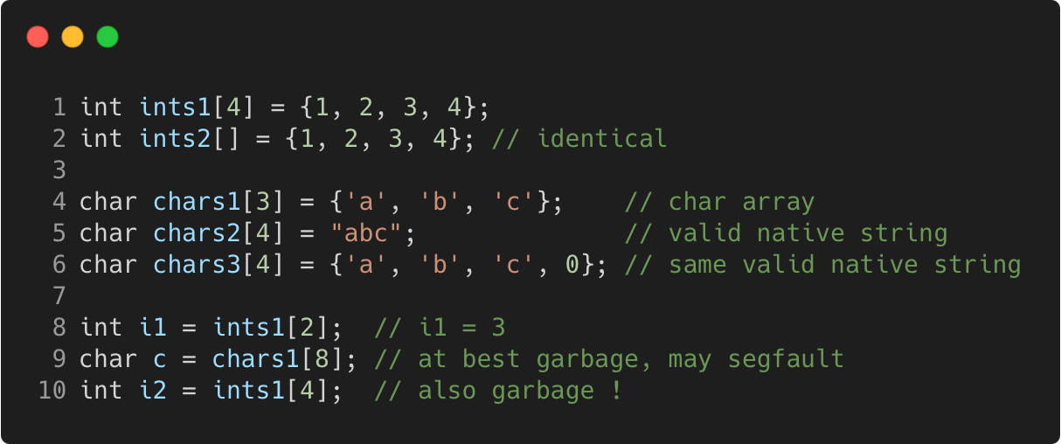
Static arrays
C++98
Language Basics | Arrays and Pointers
Gammasoft
Modern C++ Course

Slide 94
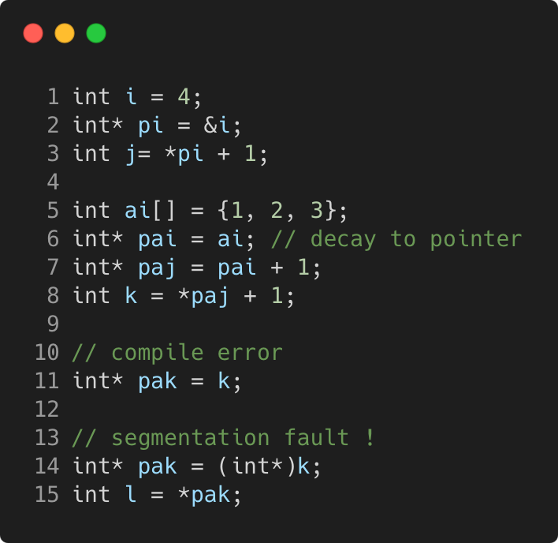
Pointers
C++98
Language Basics | Arrays and Pointers
Gammasoft
Modern C++ Course

Slide 95
Pointers
C++98
Language Basics | Arrays and Pointers
Memory layout
 | 0x3028 300
 | 0x3024
 | 0x3020 300
 | 0x301C
 | 0x3018 300
 | 0x3014
 | 0x3010 300
 | 0x300C
 | 0x3008 300
 | 0x3004
i = 4 | 0x3000 300
Gammasoft
Modern C++ Course

Slide 96
Pointers
C++98
Language Basics | Arrays and Pointers
Memory layout
 | 0x3028 300
 | 0x3024
 | 0x3020 300
 | 0x301C
 | 0x3018 300
 | 0x3014
 | 0x3010 300
 | 0x300C
 | 0x3008 300
pi = 0x3000 | 0x3004
i = 4 | 0x3000 300
Gammasoft
Modern C++ Course

Slide 97
Pointers
C++98
Language Basics | Arrays and Pointers
Memory layout
 | 0x3028 300
 | 0x3024
 | 0x3020 300
 | 0x301C
 | 0x3018 300
 | 0x3014
 | 0x3010 300
 | 0x300C
j = 5 | 0x3008 300
pi = 0x3000 | 0x3004
i = 4 | 0x3000 300
Gammasoft
Modern C++ Course

Slide 98
Pointers
C++98
Language Basics | Arrays and Pointers
Memory layout
 | 0x3028 300
 | 0x3024
 | 0x3020 300
 | 0x301C
 | 0x3018 300
ai[2] = 3 | 0x3014
ai[1] = 2 | 0x3010 300
ai[0] = 1 | 0x300C
j = 5 | 0x3008 300
pi = 0x3000 | 0x3004
i = 4 | 0x3000 300
Gammasoft
Modern C++ Course

Slide 99
Pointers
C++98
Language Basics | Arrays and Pointers
Memory layout
 | 0x3028 300
 | 0x3024
 | 0x3020 300
 | 0x301C
pai = 0x300C | 0x3018 300
ai[2] = 3 | 0x3014
ai[1] = 2 | 0x3010 300
ai[0] = 1 | 0x300C
j = 5 | 0x3008 300
pi = 0x3000 | 0x3004
i = 4 | 0x3000 300
Gammasoft
Modern C++ Course

Slide 100
Pointers
C++98
Language Basics | Arrays and Pointers
Memory layout
 | 0x3028 300
 | 0x3024
 | 0x3020 300
paj = 0x3010 | 0x301C
pai = 0x300C | 0x3018 300
ai[2] = 3 | 0x3014
ai[1] = 2 | 0x3010 300
ai[0] = 1 | 0x300C
j = 5 | 0x3008 300
pi = 0x3000 | 0x3004
i = 4 | 0x3000 300
Gammasoft
Modern C++ Course

Slide 101
Pointers
C++98
Language Basics | Arrays and Pointers
Memory layout
 | 0x3028 300
 | 0x3024
k = 3 | 0x3020 300
paj = 0x3010 | 0x301C
pai = 0x300C | 0x3018 300
ai[2] = 3 | 0x3014
ai[1] = 2 | 0x3010 300
ai[0] = 1 | 0x300C
j = 5 | 0x3008 300
pi = 0x3000 | 0x3004
i = 4 | 0x3000 300
Gammasoft
Modern C++ Course

Slide 102
Pointers
C++98
Language Basics | Arrays and Pointers
Memory layout
 | 0x3028 300
pak = 3 | 0x3024
k = 3 | 0x3020 300
paj = 0x3010 | 0x301C
pai = 0x300C | 0x3018 300
ai[2] = 3 | 0x3014
ai[1] = 2 | 0x3010 300
ai[0] = 1 | 0x300C
j = 5 | 0x3008 300
pi = 0x3000 | 0x3004
i = 4 | 0x3000 300
??
Gammasoft
Modern C++ Course

Slide 103
nullptr
C++11
Language Basics | Arrays and Pointers
if a pointer doesn’t point to anything, set it to nullptr
useful to e.g. mark the end of a linked data structure
or absence of an optional function argument (pointer)
same as setting it to 0 or NULL (before C++ 11)
triggers compilation error when assigned to integer
Gammasoft
Modern C++ Course

Slide 104
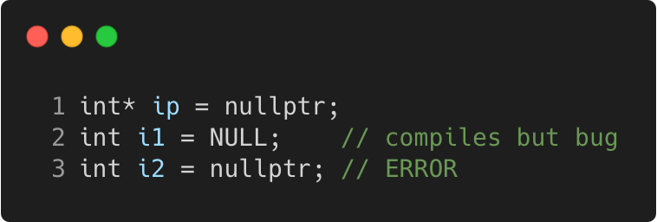
nullptr
C++11
Language Basics | Arrays and Pointers
if a pointer doesn’t point to anything, set it to nullptr
useful to e.g. mark the end of a linked data structure
or absence of an optional function argument (pointer)
same as setting it to 0 or NULL (before C++ 11)
triggers compilation error when assigned to integer
Gammasoft
Modern C++ Course

Slide 105
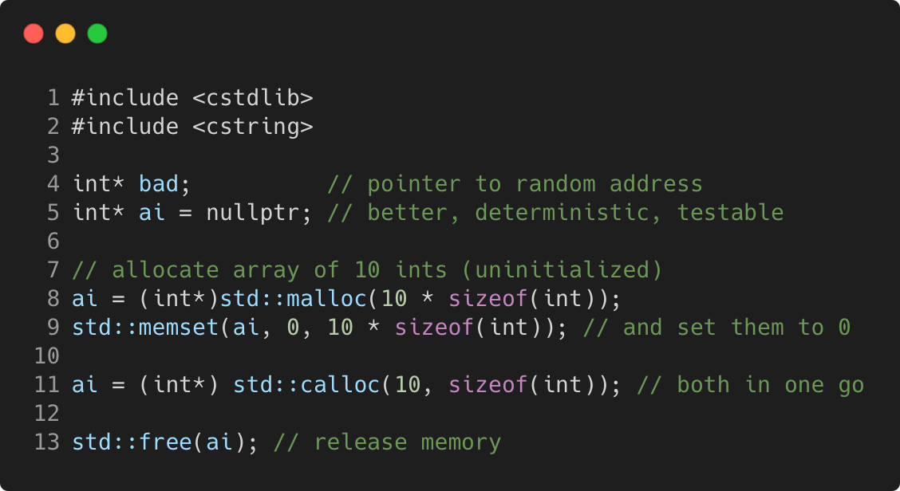
Dynamic arrays using C
C++98
Language Basics | Arrays and Pointers
Gammasoft
Modern C++ Course

Slide 106
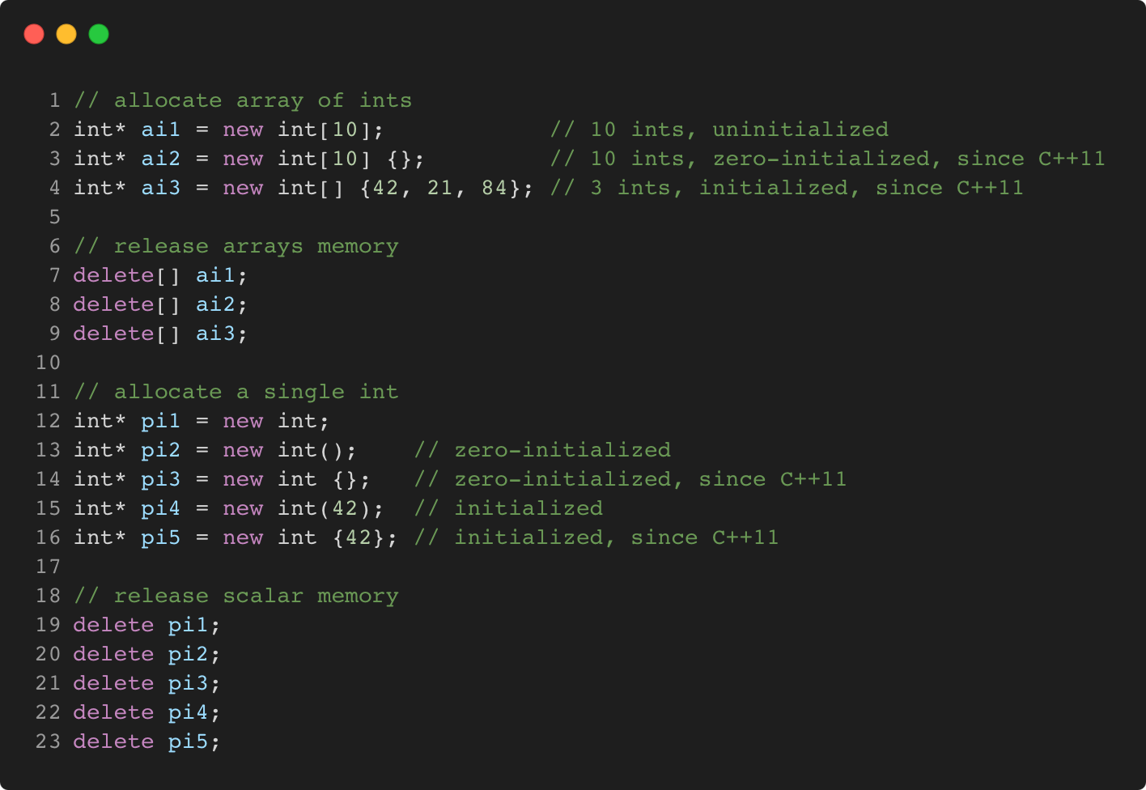
Dynamic arrays using C++
C++98
Language Basics | Arrays and Pointers
Gammasoft
Modern C++ Course

Slide 107
Language Basics
Language Basics
Gammasoft
Modern C++ Course
Hello World
Core syntax and types
Arrays and Pointers
Scopes / namespaces
Struct and enum types
References
Functions
Operators
Control structures
Headers and interfaces
auto keyword
inline keyword
Assertions

Slide 108
Language Basics
Language Basics
Gammasoft
Modern C++ Course
Hello World
Core syntax and types
Arrays and Pointers
Scopes / namespaces
Struct and enum types
References
Functions
Operators
Control structures
Headers and interfaces
auto keyword
inline keyword
Assertions

Slide 109
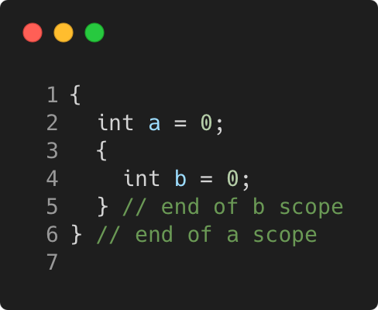
Scope
C++98
Language Basics | Scopes / namespaces
Portion of the source code where a given name is valid
Typically :
simple block of code, within {}
function, class, namespace
the global scope, i.e. translation unit (.cpp file + all includes)
Gammasoft
Modern C++ Course

Slide 110
Scope and lifetime of variables
C++98
Language Basics | Scopes / namespaces
Variables are (statically) allocated when defined
Variables are freed at the end of a scope
Gammasoft
Modern C++ Course

Slide 111
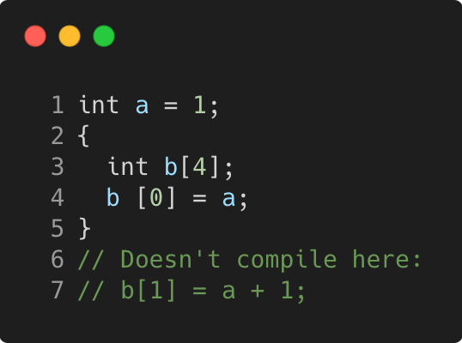
Scope and lifetime of variables
C++98
Language Basics | Scopes / namespaces
Variables are (statically) allocated when defined
Variables are freed at the end of a scope
Gammasoft
Modern C++ Course

Slide 112
Scope and lifetime of variables
C++98
Language Basics | Scopes / namespaces
Variables are (statically) allocated when defined
Variables are freed at the end of a scope
Memory layout
 | 0x3010
 | 0x300C
 | 0x3008
 | 0x3004
i = 4 | 0x3000
Gammasoft
Modern C++ Course

Slide 113
Scope and lifetime of variables
C++98
Language Basics | Scopes / namespaces
Variables are (statically) allocated when defined
Variables are freed at the end of a scope
Memory layout
b[3] = ? | 0x3010
b[2] = ? | 0x300C
b[1] = ? | 0x3008
b[0] = ? | 0x3004
i = 4 | 0x3000
Gammasoft
Modern C++ Course

Slide 114
Scope and lifetime of variables
C++98
Language Basics | Scopes / namespaces
Variables are (statically) allocated when defined
Variables are freed at the end of a scope
Memory layout
b[3] = ? | 0x3010
b[2] = ? | 0x300C
b[1] = ? | 0x3008
b[0] = 1 | 0x3004
i = 4 | 0x3000
Gammasoft
Modern C++ Course

Slide 115
Scope and lifetime of variables
C++98
Language Basics | Scopes / namespaces
Variables are (statically) allocated when defined
Variables are freed at the end of a scope
Memory layout
? | 0x3010
? | 0x300C
? | 0x3008
1 | 0x3004
i = 4 | 0x3000
Gammasoft
Modern C++ Course

Slide 116
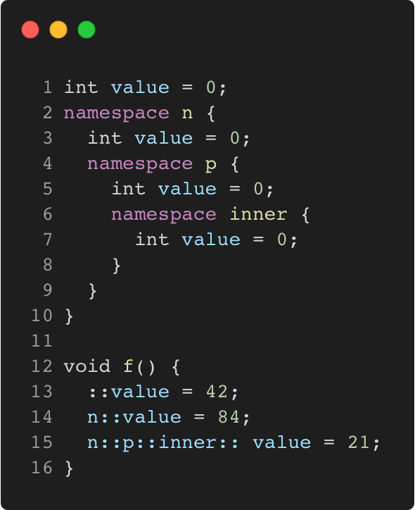
Namepaces
C++98
Language Basics | Scopes / namespaces
Namespaces allow to segment your code to avoid name clashes
They can be embedded to create hierarchies (separator is ::)
Gammasoft
Modern C++ Course

Slide 117
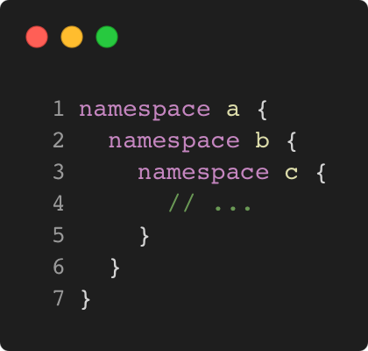
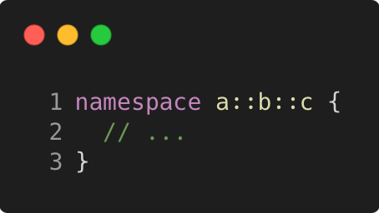
Nested namespaces
C++17
Language Basics | Scopes / namespaces
Easier way to declare nested namespaces
C++98
C++17
Gammasoft
Modern C++ Course

Slide 118
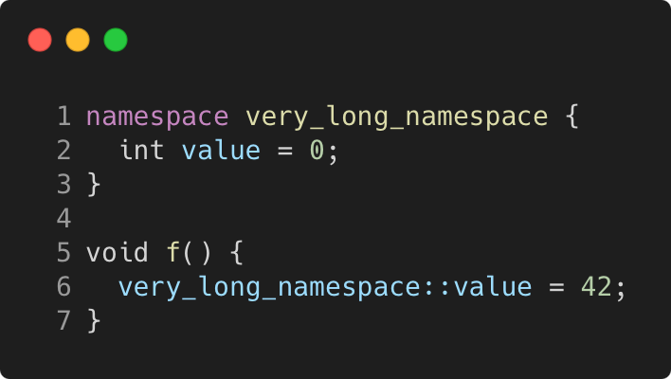
namespace alias
C++98
Language Basics | Scopes / namespaces
The namespace keyword can be use to create an alias on an other namespace.
Gammasoft
Modern C++ Course

Slide 119
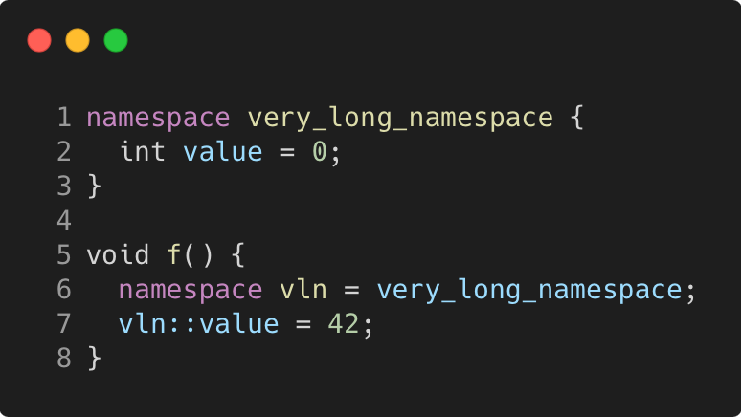
namespace alias
C++98
Language Basics | Scopes / namespaces
The namespace keyword can be use to create an alias on an other namespace.
Gammasoft
Modern C++ Course

Slide 120
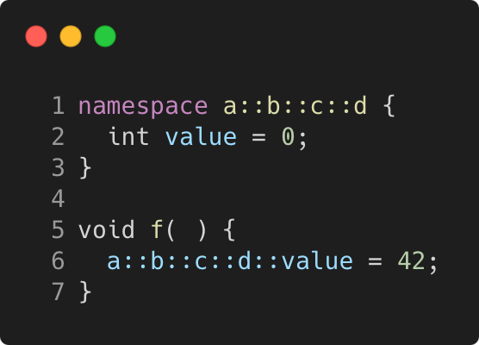
namespace alias
C++98
Language Basics | Scopes / namespaces
The namespace keyword can be use to create an alias on an other namespace.
Or on nested namespaces.
Gammasoft
Modern C++ Course

Slide 121
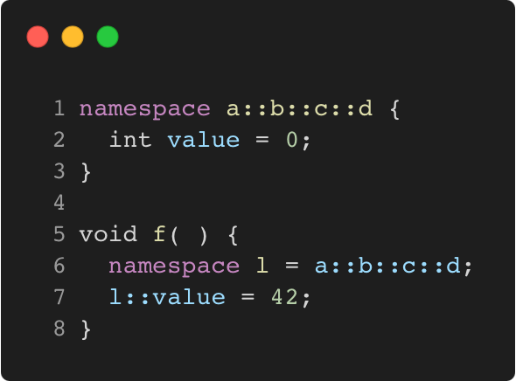
namespace alias
C++98
Language Basics | Scopes / namespaces
The namespace keyword can be use to create an alias on an other namespace.
Or on nested namespaces.
Gammasoft
Modern C++ Course

Slide 122
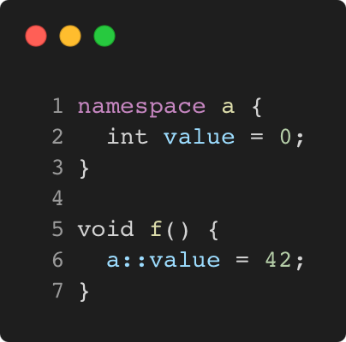
Using namespace directive
C++98
Language Basics | Scopes / namespaces
The using namespace directive make all members of the specified namespace visible in current scope.
Gammasoft
Modern C++ Course

Slide 123
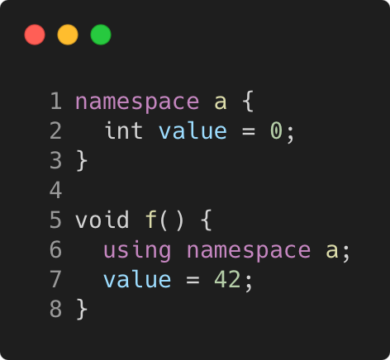
Using namespace directive
C++98
Language Basics | Scopes / namespaces
The using namespace directive make all members of the specified namespace visible in current scope.
Gammasoft
Modern C++ Course

Slide 124
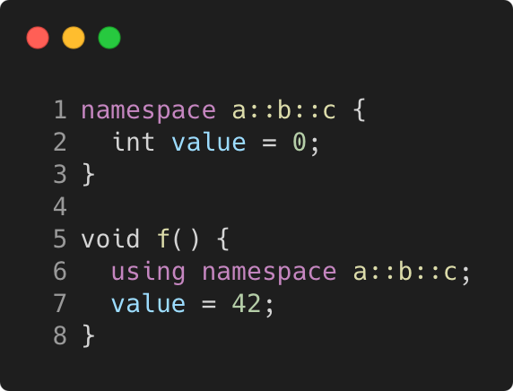
Using namespace directive
C++98
Language Basics | Scopes / namespaces
The using namespace directive make all members of the specified namespace visible in current scope.
The same for nested namespaces.
Gammasoft
Modern C++ Course

Slide 125
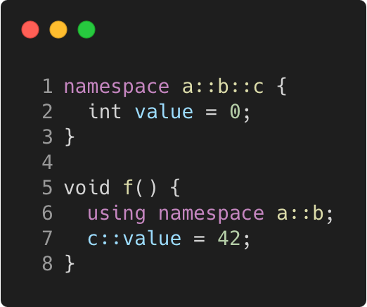
Using namespace directive
C++98
Language Basics | Scopes / namespaces
The using namespace directive make all members of the specified namespace visible in current scope.
The same for nested namespaces.
As well as for any part of the nested namespaces.
Gammasoft
Modern C++ Course

Slide 126
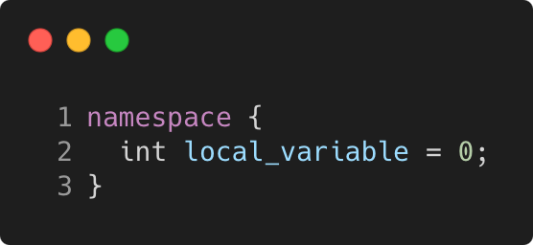
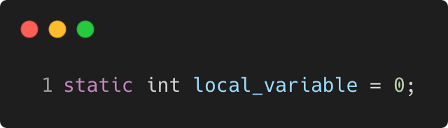
Anonymous namespace
C++98
Language Basics | Scopes / namespaces
groups a number of declarations
visible only in the current translation unit
but not reusable outside
allows much better compiler optimizations and checking
e.g. unused function warning
context dependent optimizations
equivalent
Gammasoft
Modern C++ Course

Slide 127
Language Basics
Language Basics
Gammasoft
Modern C++ Course
Hello World
Core syntax and types
Arrays and Pointers
Scopes / namespaces
Struct and enum types
References
Functions
Operators
Control structures
Headers and interfaces
auto keyword
inline keyword
Assertions

Slide 128
Language Basics
Language Basics
Gammasoft
Modern C++ Course
Hello World
Core syntax and types
Arrays and Pointers
Scopes / namespaces
Struct and enum types
References
Functions
Operators
Control structures
Headers and interfaces
auto keyword
inline keyword
Assertions

Slide 129
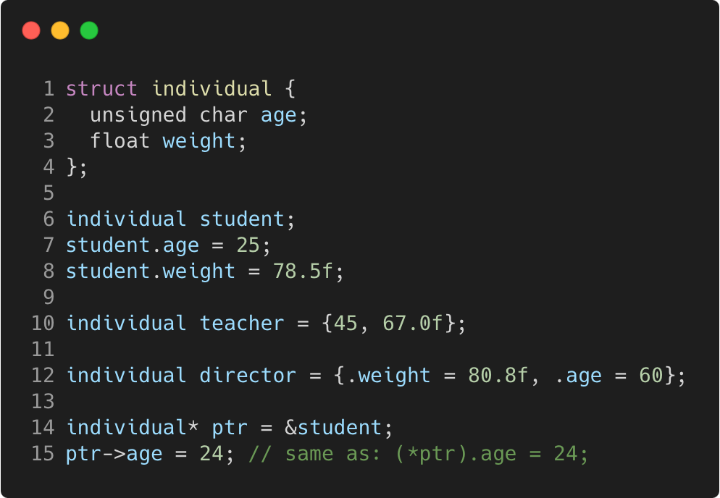
Struct
C++98
Language Basics | Struct and enum types
“members” grouped together under one name
Gammasoft
Modern C++ Course

Slide 130
Struct
C++98
Language Basics | Struct and enum types
“members” grouped together under one name
Memory layout
 |  |  |  | 0x3018
 |  |  |  | 0x3014
 |  |  |  | 0x3010
 |  |  |  | 0x300C
 |  |  |  | 0x3008
 |  |  |  | 0x3004
 |  |  |  | 0x3000
Gammasoft
Modern C++ Course

Slide 131
Struct
C++98
Language Basics | Struct and enum types
“members” grouped together under one name
Memory layout
 |  |  |  | 0x3018
 |  |  |  | 0x3014
 |  |  |  | 0x3010
 |  |  |  | 0x300C
 |  |  |  | 0x3008
? | ? | ? | ? | 0x3004
? | ? | ? | ? | 0x3000
{
student
Gammasoft
Modern C++ Course

Slide 132
Struct
C++98
Language Basics | Struct and enum types
“members” grouped together under one name
Memory layout
 |  |  |  | 0x3018
 |  |  |  | 0x3014
 |  |  |  | 0x3010
 |  |  |  | 0x300C
 |  |  |  | 0x3008
? | ? | ? | ? | 0x3004
25 | ? | ? | ? | 0x3000
{
student
Gammasoft
Modern C++ Course

Slide 133
Struct
C++98
Language Basics | Struct and enum types
“members” grouped together under one name
Memory layout
 |  |  |  | 0x3018
 |  |  |  | 0x3014
 |  |  |  | 0x3010
 |  |  |  | 0x300C
 |  |  |  | 0x3008
 |  |  |  | 0x3004
25 | ? | ? | ? | 0x3000
{
78.5
student
Gammasoft
Modern C++ Course

Slide 134
Struct
C++98
Language Basics | Struct and enum types
“members” grouped together under one name
Memory layout
 |  |  |  | 0x3018
 |  |  |  | 0x3014
 |  |  |  | 0x3010
 |  |  |  | 0x300C
45 | ? | ? | ? | 0x3008
 |  |  |  | 0x3004
25 | ? | ? | ? | 0x3000
{
67.0
teacher
{
78.5
student
Gammasoft
Modern C++ Course

Slide 135
Struct
C++98
Language Basics | Struct and enum types
“members” grouped together under one name
Memory layout
{
 |  |  |  | 0x3018
 |  |  |  | 0x3014
60 | ? | ? | ? | 0x3010
 |  |  |  | 0x300C
45 | ? | ? | ? | 0x3008
 |  |  |  | 0x3004
25 | ? | ? | ? | 0x3000
director
80.8
{
67.0
teacher
{
78.5
student
Gammasoft
Modern C++ Course

Slide 136
Struct
C++98
Language Basics | Struct and enum types
“members” grouped together under one name
Memory layout
 |  |  |  | 0x3018
 |  |  |  | 0x3014
60 | ? | ? | ? | 0x3010
 |  |  |  | 0x300C
45 | ? | ? | ? | 0x3008
 |  |  |  | 0x3004
25 | ? | ? | ? | 0x3000
{
0x3000
director
80.8
{
67.0
teacher
{
78.5
student
Gammasoft
Modern C++ Course

Slide 137
Struct
C++98
Language Basics | Struct and enum types
“members” grouped together under one name
Memory layout
 |  |  |  | 0x3018
 |  |  |  | 0x3014
60 | ? | ? | ? | 0x3010
 |  |  |  | 0x300C
45 | ? | ? | ? | 0x3008
 |  |  |  | 0x3004
24 | ? | ? | ? | 0x3000
{
0x3000
director
80.8
{
67.0
teacher
{
78.5
student
Gammasoft
Modern C++ Course

Slide 138
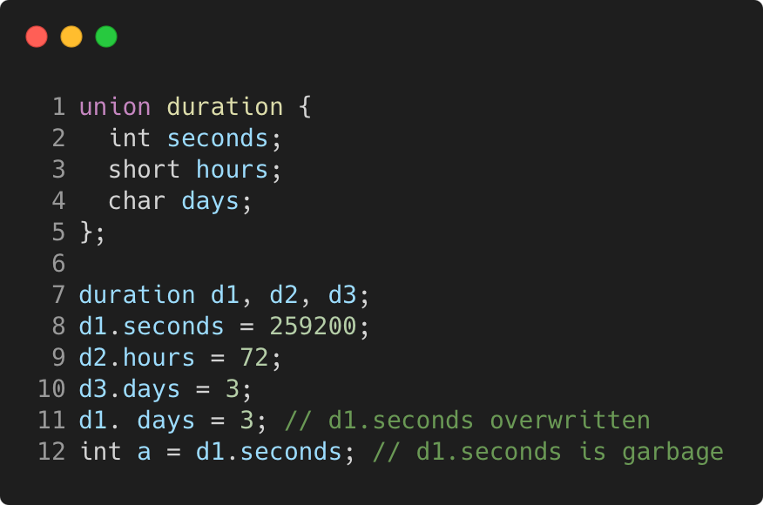
Union
C++98
Language Basics | Struct and enum types
“members” packed together at same memory location
Gammasoft
Modern C++ Course

Slide 139
Union
C++98
Language Basics | Struct and enum types
“members” packed together at same memory location
Memory layout
 |  |  |  | 0x300C
 |  |  |  | 0x3008
 |  |  |  | 0x3004
 |  |  |  | 0x3000
Gammasoft
Modern C++ Course

Slide 140
Union
C++98
Language Basics | Struct and enum types
“members” packed together at same memory location
Memory layout
 |  |  |  | 0x300C
? | ? | ? | ? | 0x3008
? | ? | ? | ? | 0x3004
? | ? | ? | ? | 0x3000
Gammasoft
Modern C++ Course

Slide 141
Union
C++98
Language Basics | Struct and enum types
“members” packed together at same memory location
Memory layout
 |  |  |  | 0x300C
? | ? | ? | ? | 0x3008
? | ? | ? | ? | 0x3004
 |  |  |  | 0x3000
259200
Gammasoft
Modern C++ Course

Slide 142
Union
C++98
Language Basics | Struct and enum types
“members” packed together at same memory location
Memory layout
 |  |  |  | 0x300C
? | ? | ? | ? | 0x3008
 |  | ? | ? | 0x3004
 |  |  |  | 0x3000
72
259200
Gammasoft
Modern C++ Course

Slide 143
Union
C++98
Language Basics | Struct and enum types
“members” packed together at same memory location
Memory layout
 |  |  |  | 0x300C
3 | ? | ? | ? | 0x3008
 |  | ? | ? | 0x3004
 |  |  |  | 0x3000
72
259200
Gammasoft
Modern C++ Course

Slide 144
Union
C++98
Language Basics | Struct and enum types
“members” packed together at same memory location
Memory layout
 |  |  |  | 0x300C
3 | ? | ? | ? | 0x3008
 |  | ? | ? | 0x3004
3 | ? | ? | ? | 0x3000
72
Gammasoft
Modern C++ Course

Slide 145
Union
C++98
Language Basics | Struct and enum types
“members” packed together at same memory location
Memory layout
? | ? | ? | ? | 0x300C
3 | ? | ? | ? | 0x3008
 |  | ? | ? | 0x3004
3 | ? | ? | ? | 0x3000
72
Gammasoft
Modern C++ Course

Slide 146
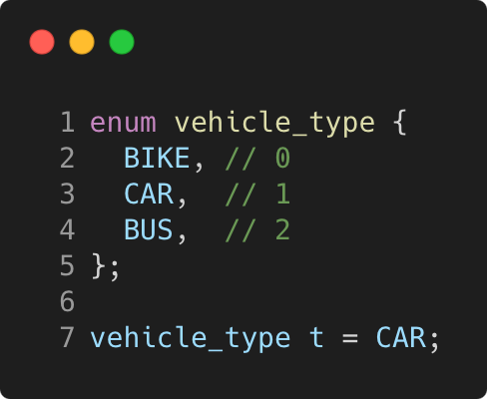
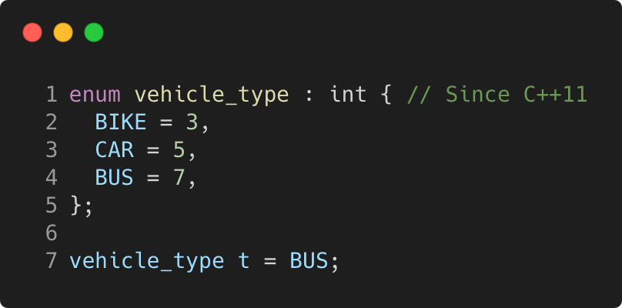
Enum
C++98
Language Basics | Struct and enum types
use to declare a list of related constants (enumerators)
has an underlying integral type
enumerator names leak into enclosing scope
Gammasoft
Modern C++ Course

Slide 147
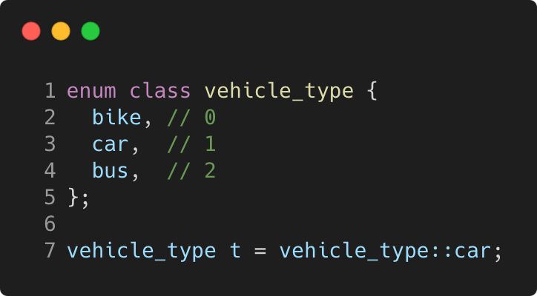
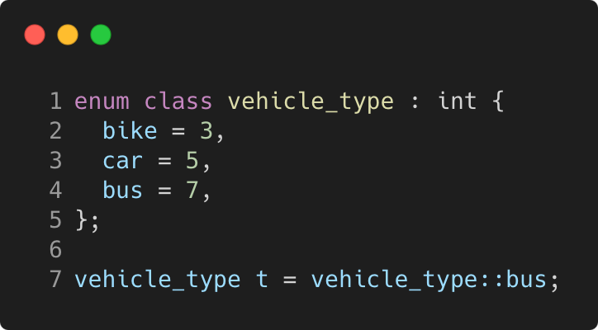
Enum class
C++11
Language Basics | Struct and enum types
scopes enumerator names, avoids name clashes
strong typing, no automatic conversion to int
Gammasoft
Modern C++ Course

Slide 148
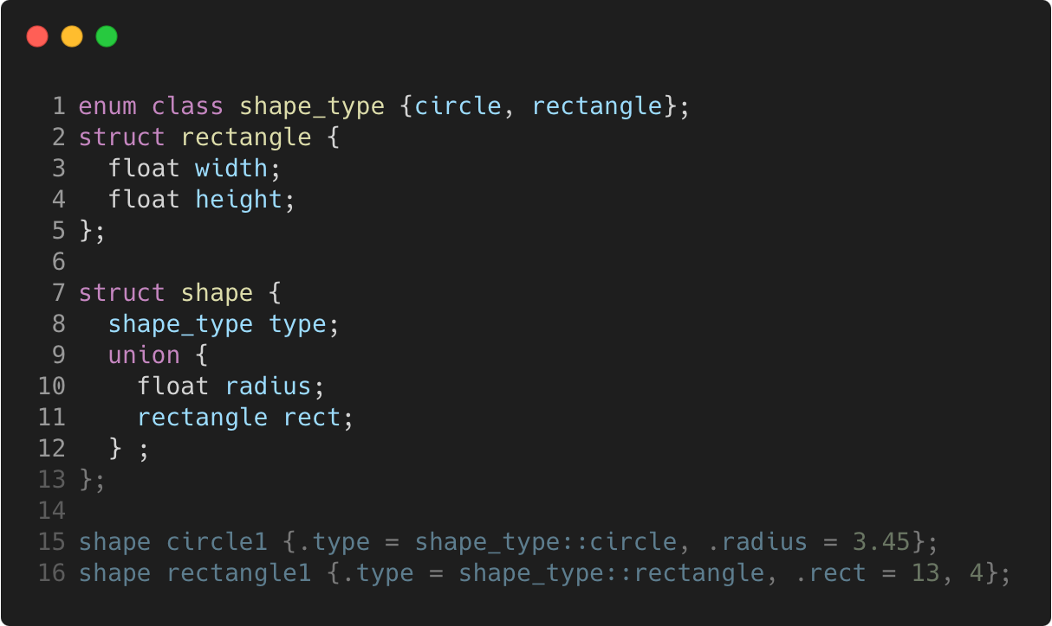
More concrete example
C++11
Language Basics | Struct and enum types
Gammasoft
Modern C++ Course

Slide 149
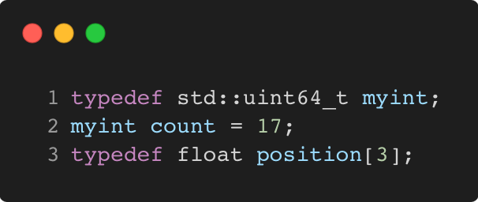

typedef and using
C++98 / C++11
Language Basics | Struct and enum types
C++98
C++11
Gammasoft
Modern C++ Course

Slide 150
Language Basics
Language Basics
Gammasoft
Modern C++ Course
Hello World
Core syntax and types
Arrays and Pointers
Scopes / namespaces
Struct and enum types
References
Functions
Operators
Control structures
Headers and interfaces
auto keyword
inline keyword
Assertions

Slide 151
Language Basics
Language Basics
Gammasoft
Modern C++ Course
Hello World
Core syntax and types
Arrays and Pointers
Scopes / namespaces
Struct and enum types
References
Functions
Operators
Control structures
Headers and interfaces
auto keyword
inline keyword
Assertions

Slide 152

References
C++98
Language Basics | References
References allow for direct access to another object
They can be used as shortcuts / better readability
They can be declared const to allow only read access
Gammasoft
Modern C++ Course

Slide 153
References vs pointers
C++98
Language Basics | References
Natural syntax
Cannot be null
Must be assigned when defined, cannot be reassigned
Prefer using references instead of pointers
Mark references const to prevent modification
Gammasoft
Modern C++ Course

Slide 154
Language Basics
Language Basics
Gammasoft
Modern C++ Course
Hello World
Core syntax and types
Arrays and Pointers
Scopes / namespaces
Struct and enum types
References
Functions
Operators
Control structures
Headers and interfaces
auto keyword
inline keyword
Assertions

Slide 155
Language Basics
Language Basics
Gammasoft
Modern C++ Course
Hello World
Core syntax and types
Arrays and Pointers
Scopes / namespaces
Struct and enum types
References
Functions
Operators
Control structures
Headers and interfaces
auto keyword
inline keyword
Assertions

Slide 156

Function without param and no return
C++98
Language Basics | Functions
Gammasoft
Modern C++ Course

Slide 157

Function without param and return
C++98
Language Basics | Functions
Gammasoft
Modern C++ Course

Slide 158

Function with param and no return
C++98
Language Basics | Functions
Gammasoft
Modern C++ Course

Slide 159

Function with param and return
C++98
Language Basics | Functions
Gammasoft
Modern C++ Course

Slide 160

Function with params and return
C++98
Language Basics | Functions
Gammasoft
Modern C++ Course

Slide 161

Function with default argument
C++98
Language Basics | Functions
Gammasoft
Modern C++ Course

Slide 162

Function with default arguments
C++98
Language Basics | Functions
Gammasoft
Modern C++ Course

Slide 163

Functions and references to returned values
C++98
Language Basics | Functions
Gammasoft
Modern C++ Course

Slide 164

Parameters are passed by value
C++98
Language Basics | Functions
Gammasoft
Modern C++ Course

Slide 165

Parameters are passed by value
C++98
Language Basics | Functions
Memory layout
 | 0x31E0
 | 0x3190
 | 0x3140
 | 0x30F0
 | 0x30A0
 | 0x3050
 | 0x3000
Gammasoft
Modern C++ Course

Slide 166
Parameters are passed by value
C++98
Language Basics | Functions
Memory layout
 | 0x31E0
 | 0x3190
 | 0x3140
 | 0x30F0
sn | 0x30A0
... | 0x3050
s1 | 0x3000
{
s
Gammasoft
Modern C++ Course

Slide 167
Parameters are passed by value
C++98
Language Basics | Functions
Memory layout
{
 | 0x31E0
pn | 0x3190
... | 0x3140
p1 | 0x30F0
sn | 0x30A0
... | 0x3050
s1 | 0x3000
p
{
s
Gammasoft
Modern C++ Course

Slide 168
Parameters are passed by value
C++98
Language Basics | Functions
Memory layout
 | 0x31E0
 | 0x3190
 | 0x3140
q = 0x3000 | 0x30F0
sn | 0x30A0
... | 0x3050
s1 | 0x3000
{
s
Gammasoft
Modern C++ Course

Slide 169

Pass by value or reference ?
C++98
Language Basics | Functions
Gammasoft
Modern C++ Course

Slide 170
Pass by value or reference ?
C++98
Language Basics | Functions
Memory layout
 | 0x3008
 | 0x3004
 | 0x3000
Gammasoft
Modern C++ Course

Slide 171
Pass by value or reference ?
C++98
Language Basics | Functions
Memory layout
 | 0x3008
 | 0x3004
s.a = 1 | 0x3000
Gammasoft
Modern C++ Course

Slide 172
Pass by value or reference ?
C++98
Language Basics | Functions
Memory layout
 | 0x3008
p.a = 1 | 0x3004
s.a = 1 | 0x3000
Gammasoft
Modern C++ Course

Slide 173
Pass by value or reference ?
C++98
Language Basics | Functions
Memory layout
 | 0x3008
p.a = 2 | 0x3004
s.a = 1 | 0x3000
Gammasoft
Modern C++ Course

Slide 174
Pass by value or reference ?
C++98
Language Basics | Functions
Memory layout
 | 0x3008
 | 0x3004
s.a = 1 | 0x3000
Gammasoft
Modern C++ Course

Slide 175
Pass by value or reference ?
C++98
Language Basics | Functions
Memory layout
 | 0x3008
q = 0x3000 | 0x3004
s.a = 1 | 0x3000
Gammasoft
Modern C++ Course

Slide 176
Pass by value or reference ?
C++98
Language Basics | Functions
Memory layout
 | 0x3008
q = 0x3000 | 0x3004
s.a = 2 | 0x3000
Gammasoft
Modern C++ Course

Slide 177
Pass by value or reference ?
C++98
Language Basics | Functions
Memory layout
 | 0x3008
 | 0x3004
s.a = 2 | 0x3000
Gammasoft
Modern C++ Course

Slide 178

Different ways to pass arguments to a function
C++98
Language Basics | Functions
By default, arguments are passed by value (= copy) => good for small types, e.g. numbers
Use references for parameters to avoid copies => good for large types, e.g. objects
Use const for safety and readability whenever possible
Gammasoft
Modern C++ Course

Slide 179

Overloading
C++98
Language Basics | Functions
We can have multiple functions with the same name
Must have different parameter lists
A different return type alone is not allowed
Form a so-called “overload set”
Default arguments can cause ambiguities
Gammasoft
Modern C++ Course

Slide 180
Exercise : functions
Language Basics | Functions
Familiarise yourself with pass by value / pass by reference.
Go to exercises/functions
Look at functions.cpp
Compile it (make) and run the program (./functions)
Work on the tasks that you find in functions.cpp
Gammasoft
Modern C++ Course

Slide 181

Good practices
C++98
Language Basics | Functions
Write readable functions
Keep functions short
Do one logical thing (single-responsibility principle)
Use expressive names
Document non-trivial functions
Gammasoft
Modern C++ Course

Slide 182

Good practices
C++98
Language Basics | Functions
Don’t! Everything in one long function
Gammasoft
Modern C++ Course

Slide 183
Language Basics
Language Basics
Gammasoft
Modern C++ Course
Hello World
Core syntax and types
Arrays and Pointers
Scopes / namespaces
Struct and enum types
References
Functions
Operators
Control structures
Headers and interfaces
auto keyword
inline keyword
Assertions

Slide 184
Language Basics
Language Basics
Gammasoft
Modern C++ Course
Hello World
Core syntax and types
Arrays and Pointers
Scopes / namespaces
Struct and enum types
References
Functions
Operators
Control structures
Headers and interfaces
auto keyword
inline keyword
Assertions

Slide 185

Binary and Assignment Operators
C++98
Language Basics | Operators
Gammasoft
Modern C++ Course

Slide 186

Increment / Decrement Operators
C++98
Language Basics | Operators
Gammasoft
Modern C++ Course

Slide 187

Bitwise and Assignment Operators
C++98
Language Basics | Operators
Gammasoft
Modern C++ Course

Slide 188

Logical Operators
C++98
Language Basics | Operators
Gammasoft
Modern C++ Course

Slide 189

Comparison Operators
C++20
Language Basics | Operators
Gammasoft
Modern C++ Course

Slide 190

Operator Precedences
C++98
Language Basics | Operators
Avoid writing a line of operators as in the example on the right
It's better to decompose the expression
and to use parentheses
Details can be found on cppreference
Gammasoft
Modern C++ Course

Slide 191
Language Basics
Language Basics
Gammasoft
Modern C++ Course
Hello World
Core syntax and types
Arrays and Pointers
Scopes / namespaces
Struct and enum types
References
Functions
Operators
Control structures
Headers and interfaces
auto keyword
inline keyword
Assertions

Slide 192
Language Basics
Language Basics
Gammasoft
Modern C++ Course
Hello World
Core syntax and types
Arrays and Pointers
Scopes / namespaces
Struct and enum types
References
Functions
Operators
Control structures
Headers and interfaces
auto keyword
inline keyword
Assertions

Slide 193

if - syntax
C++98
Language Basics | Control structures
The else and else if clauses are optional
The else if clause can be repeated
Braces are optional if there is a single statement
Gammasoft
Modern C++ Course

Slide 194

if - example
C++98
Language Basics | Control structures
Gammasoft
Modern C++ Course

Slide 195

Conditional operator - syntax
C++98
Language Basics | Control structures
If test is true expression1 is returned
Else, expression2 is returned
Gammasoft
Modern C++ Course

Slide 196

Conditional operator - example
C++98
Language Basics | Control structures
Gammasoft
Modern C++ Course

Slide 197

Conditional operator - best practice
C++98
Language Basics | Control structures
Avoid writing a line of conditional operators as in the example on the right
Explicit ifs are generally easier to read
Use the ternary operator with short conditions and expressions
Avoid nesting
Gammasoft
Modern C++ Course

Slide 198

switch - syntax
C++98
Language Basics | Control structures
The break statement is not mandatory but...
Cases are entry points, not independent pieces
Execution “falls through” to the next case without a break!
The default case may be omitted
Avoid switch statements with fall-through cases
Gammasoft
Modern C++ Course

Slide 199

switch - example
C++11
Language Basics | Control structures
Gammasoft
Modern C++ Course

Slide 200

[[fallthrough]] attribute
C++17
Language Basics | Control structures
New compiler warning
Since C++ 17, compilers are encouraged to warn on fall-through
Gammasoft
Modern C++ Course

Slide 201

Init-statements for if and switch
C++17
Language Basics | Control structures
Purpose
Allows to limit variable scope in if and switch statements
Gammasoft
Modern C++ Course

Slide 202

Init-statements for if and switch
C++98
Language Basics | Control structures
Don’t confuse with a variable declaration as condition!
Gammasoft
Modern C++ Course

Slide 203

for loop - syntax
C++98
Language Basics | Control structures
Multiple initializations / increments are comma separated
Initializations can contain declarations
Braces are optional if loop body is a single statement
Gammasoft
Modern C++ Course

Slide 204

for loop - example
C++98
Language Basics | Control structures
Gammasoft
Modern C++ Course

Slide 205

Range-based loop - syntax
C++11
Language Basics | Control structures
Simplifies loops over “ranges” tremendously
Especially with std containers and ranges
Gammasoft
Modern C++ Course

Slide 206

Range-based loop - example
C++11
Language Basics | Control structures
Gammasoft
Modern C++ Course

Slide 207

Init-statements for range-based loop
C++20
Language Basics | Control structures
Purpose
Allows to limit variable scope in range-based loops
Gammasoft
Modern C++ Course

Slide 208

while loop - syntax
C++98
Language Basics | Control structures
Braces are optional if loop body is a single statement
Gammasoft
Modern C++ Course

Slide 209


while loop - example
C++98
Language Basics | Control structures
Gammasoft
Modern C++ Course

Slide 210
Jump statements
C++98
Language Basics | Control structures
Gammasoft
Modern C++ Course

Slide 211

Jump statements
C++98
Language Basics | Control structures
break Exits the loop and continues after it
Gammasoft
Modern C++ Course

Slide 212

Jump statements
C++98
Language Basics | Control structures
break Exits the loop and continues after it
continue Goes immediately to next loop iteration
Gammasoft
Modern C++ Course

Slide 213

Jump statements
C++98
Language Basics | Control structures
break Exits the loop and continues after it
continue Goes immediately to next loop iteration
return Exits the current function
Gammasoft
Modern C++ Course

Slide 214

Jump statements
C++98
Language Basics | Control structures
break Exits the loop and continues after it
continue Goes immediately to next loop iteration
return Exits the current function
Gammasoft
Modern C++ Course

Slide 215

Jump statements
C++98
Language Basics | Control structures
break Exits the loop and continues after it
continue Goes immediately to next loop iteration
return Exits the current function
goto Can jump anywhere inside a function, avoid!
Gammasoft
Modern C++ Course

Slide 216
Exercise : control
Language Basics | Control structures
Familiarise yourself with different kinds of control structures.
Re-implement them in different ways.
Go to exercises/control
Look at control.cpp
Compile it (make) and run the program (./control)
Work on the tasks that you find in README.md
Gammasoft
Modern C++ Course

Slide 217
Language Basics
Language Basics
Gammasoft
Modern C++ Course
Hello World
Core syntax and types
Arrays and Pointers
Scopes / namespaces
Struct and enum types
References
Functions
Operators
Control structures
Headers and interfaces
auto keyword
inline keyword
Assertions

Slide 218
Language Basics
Language Basics
Gammasoft
Modern C++ Course
Hello World
Core syntax and types
Arrays and Pointers
Scopes / namespaces
Struct and enum types
References
Functions
Operators
Control structures
Headers and interfaces
auto keyword
inline keyword
Assertions

Slide 219
Interface
C++98
Language Basics | Headers and interfaces
Set of declarations defining some functionality
Gammasoft
Modern C++ Course

Slide 220

Interface
C++98
Language Basics | Headers and interfaces
Set of declarations defining some functionality
Put in a so-called “header file”
hello.hpp
Gammasoft
Modern C++ Course

Slide 221

Interface
C++98
Language Basics | Headers and interfaces
hello.cpp
Set of declarations defining some functionality
Put in a so-called “header file”
The implementation can be found in the "source file"
Gammasoft
Modern C++ Course

Slide 222

Interface
C++98
Language Basics | Headers and interfaces
print_hello.cpp
main.cpp
print_hello.hpp
Gammasoft
Modern C++ Course

Slide 223
Preprocessor
C++98
Language Basics | Headers and interfaces
Gammasoft
Modern C++ Course

Slide 224

Preprocessor
C++98
Language Basics | Headers and interfaces
Constant macros
Gammasoft
Modern C++ Course

Slide 225

Preprocessor
C++98
Language Basics | Headers and interfaces
Constant macros
Function-style macros
Gammasoft
Modern C++ Course

Slide 226

Preprocessor
C++98
Language Basics | Headers and interfaces
Constant macros
Function-style macros
Checks
Gammasoft
Modern C++ Course

Slide 227
Preprocessor
C++98
Language Basics | Headers and interfaces
Constant macros
Function-style macros
Checks
Use preprocessor only in very restricted cases
Conditional inclusion of headers
Customization for specific compilers/platforms
Gammasoft
Modern C++ Course

Slide 228

Preprocessor
C++11
Language Basics | Headers and interfaces
Constant macros
Function-style macros
Checks
Use preprocessor only in very restricted cases
Conditional inclusion of headers
Customization for specific compilers/platforms
Gammasoft
Modern C++ Course

Slide 229

Preprocessor
C++98
Language Basics | Headers and interfaces
Constant macros
Function-style macros
Checks
Use preprocessor only in very restricted cases
Conditional inclusion of headers
Customization for specific compilers/platforms
Gammasoft
Modern C++ Course

Slide 230
Header include guards
C++98
Language Basics | Headers and interfaces
Problem: redefinition by accident
Headers may define new names (e.g. types)
Multiple (transitive) inclusions of a header would define those
names multiple times, which is a compile error
Gammasoft
Modern C++ Course

Slide 231

Header include guards
C++98
Language Basics | Headers and interfaces
Problem: redefinition by accident
Headers may define new names (e.g. types)
Multiple (transitive) inclusions of a header would define those
names multiple times, which is a compile error
Solution: guard the content of your headers!
Include guards
Gammasoft
Modern C++ Course

Slide 232

Header include guards
C++98
Language Basics | Headers and interfaces
Include guards
Problem: redefinition by accident
Headers may define new names (e.g. types)
Multiple (transitive) inclusions of a header would define those
names multiple times, which is a compile error
Solution: guard the content of your headers!
pragma once
Gammasoft
Modern C++ Course

Slide 233
Header / source separation
C++98
Language Basics | Headers and interfaces
Headers should contain declarations of functions / classes
Only create them if interface is used somewhere else
Might be included/compiled many times
Good to keep them short
Minimise #include statements
Put long code in implementation files. Exceptions:
Templates and constexpr functions
Short functions
Gammasoft
Modern C++ Course

Slide 234
Language Basics
Language Basics
Gammasoft
Modern C++ Course
Hello World
Core syntax and types
Arrays and Pointers
Scopes / namespaces
Struct and enum types
References
Functions
Operators
Control structures
Headers and interfaces
auto keyword
inline keyword
Assertions

Slide 235
Language Basics
Language Basics
Gammasoft
Modern C++ Course
Hello World
Core syntax and types
Arrays and Pointers
Scopes / namespaces
Struct and enum types
References
Functions
Operators
Control structures
Headers and interfaces
auto keyword
inline keyword
Assertions

Slide 236
Benefits
C++11
Language Basics | auto keyword
Robustness: If the expression's type is changed—including when a function return type is changed—it just works.
Performance: You're guaranteed that there's no conversion.
Usability: You don't have to worry about type name spelling difficulties and typos.
Efficiency: Your coding can be more efficient.
Gammasoft
Modern C++ Course

Slide 237

Benefits
C++11
Language Basics | auto keyword
Robustness: If the expression's type is changed—including when a function return type is changed—it just works.
Performance: You're guaranteed that there's no conversion.
Usability: You don't have to worry about type name spelling difficulties and typos.
Efficiency: Your coding can be more efficient.
Gammasoft
Modern C++ Course

Slide 238

Benefits
C++11
Language Basics | auto keyword
Robustness: If the expression's type is changed—including when a function return type is changed—it just works.
Performance: You're guaranteed that there's no conversion.
Usability: You don't have to worry about type name spelling difficulties and typos.
Efficiency: Your coding can be more efficient.
Gammasoft
Modern C++ Course

Slide 239

Declarations
C++11
Language Basics | auto keyword
Gammasoft
Modern C++ Course

Slide 240

for range loop
C++11
Language Basics | auto keyword
Gammasoft
Modern C++ Course

Slide 241

for range loop
C++17
Language Basics | auto keyword
Gammasoft
Modern C++ Course

Slide 242

Always initialized
C++11
Language Basics | auto keyword
Gammasoft
Modern C++ Course

Slide 243
Exercise : loops, references, auto
Language Basics | Control structures
Familiarise yourself with range-based for loops and references.
Go to exercises/loops_refs_auto
Look at loops_refs_auto.cpp
Compile it (make) and run the program (./loops_refs_auto)
Work on the tasks that you find in loops_refs_auto.cpp
Gammasoft
Modern C++ Course

Slide 244
Language Basics
Language Basics
Gammasoft
Modern C++ Course
Hello World
Core syntax and types
Arrays and Pointers
Scopes / namespaces
Struct and enum types
References
Functions
Operators
Control structures
Headers and interfaces
auto keyword
inline keyword
Assertions

Slide 245
Language Basics
Language Basics
Gammasoft
Modern C++ Course
Hello World
Core syntax and types
Arrays and Pointers
Scopes / namespaces
Struct and enum types
References
Functions
Operators
Control structures
Headers and interfaces
auto keyword
inline keyword
Assertions

Slide 246

Inline functions originally
C++11
Language Basics | inline keyword
Applies to a function to tell the compiler to inline it
That is, replace function calls by the function’s content (similar to how a macro works)
Only a hint, compiler can still choose to not inline
Avoids call overhead at the cost of increasing binary size
Gammasoft
Modern C++ Course

Slide 247

Major side effect
C++11
Language Basics | inline keyword
The linker reduces the duplicated functions into one
An inline function definition can thus live in header files
Gammasoft
Modern C++ Course

Slide 248
Inline functions nowadays
C++11
Language Basics | inline keyword
Compilers can judge far better when to inline or not
thus primary purpose is gone
Putting functions into headers became main purpose
Many types of functions are marked inline by default:
function templates
constexpr functions
class member functions
Gammasoft
Modern C++ Course

Slide 249

Inline variables
C++17
Language Basics | inline keyword
my_struct.hpp
Global or static member variable specified as inline
Same side effect, linker merges all occurrences into one
Allows to define global variables/constants in headers
Avoid global variables and global constants! static member are fine.
Gammasoft
Modern C++ Course

Slide 250


Inline variables
C++17
Language Basics | inline keyword
my_struct.hpp
program.cpp
Gammasoft
Modern C++ Course

Slide 251
Language Basics
Language Basics
Gammasoft
Modern C++ Course
Hello World
Core syntax and types
Arrays and Pointers
Scopes / namespaces
Struct and enum types
References
Functions
Operators
Control structures
Headers and interfaces
auto keyword
inline keyword
Assertions

Slide 252
Language Basics
Language Basics
Gammasoft
Modern C++ Course
Hello World
Core syntax and types
Arrays and Pointers
Scopes / namespaces
Struct and enum types
References
Functions
Operators
Control structures
Headers and interfaces
auto keyword
inline keyword
Assertions

Slide 253

Checking invariants in a program
C++98
Language Basics | Assertions
An invariant is a property that is guaranteed to be true during certain phases of a program, and the program might crash or yield wrong results if it is violated
“Here, ‘a’ should always be positive”
This can be checked using assert
The program will be aborted if the assertion fails
Gammasoft
Modern C++ Course

Slide 254

Good practice
C++98
Language Basics | Assertions
Assertions are mostly for developers and debugging
Use them to check important invariants of your program
Prefer handling user-facing errors with helpful error messages/exceptions
Assertions can impact the speed of a program
Assertions are disabled when the macro NDEBUG is defined
Decide if you want to disable them when you release code
Gammasoft
Modern C++ Course

Slide 255


Static assert
C++98
Language Basics | Assertions
Checking invariants at compile time
To check invariants at compile time, use static_assert
The assertion can be any constant expression (see later)
The message argument is optional in C++ 17 and later
Gammasoft
Modern C++ Course

Slide 256
Language Basics
Language Basics
Gammasoft
Modern C++ Course
Hello World
Core syntax and types
Arrays and Pointers
Scopes / namespaces
Struct and enum types
References
Functions
Operators
Control structures
Headers and interfaces
auto keyword
inline keyword
Assertions

Slide 257
Language Basics
Language Basics
Gammasoft
Modern C++ Course
Hello World
Core syntax and types
Arrays and Pointers
Scopes / namespaces
Struct and enum types
References
Functions
Operators
Control structures
Headers and interfaces
auto keyword
inline keyword
Assertions

Slide 258
Outline
Introduction
Language Basics
Object Oriented Programming (OOP)
Core Modern C++
Modern C++ Expert
Advanced Programming
Gammasoft
Modern C++ Course

Slide 259
Outline
Introduction
Language Basics
Object Oriented Programming (OOP)
Core Modern C++
Modern C++ Expert
Advanced Programming
Gammasoft
Modern C++ Course

Slide 260
Outline
Introduction
Language Basics
Object Oriented Programming (OOP)
Core Modern C++
Modern C++ Expert
Advanced Programming
Gammasoft
Modern C++ Course

Slide 261
Outline
Introduction
Language Basics
Object Oriented Programming (OOP)
Core Modern C++
Modern C++ Expert
Advanced Programming
Gammasoft
Modern C++ Course

Slide 262
Outline
Introduction
Language Basics
Object Oriented Programming (OOP)
Core Modern C++
Modern C++ Expert
Advanced Programming
Gammasoft
Modern C++ Course

Slide 263
Outline
Introduction
Language Basics
Object Oriented Programming (OOP)
Core Modern C++
Modern C++ Expert
Advanced Programming
Gammasoft
Modern C++ Course

Slide 264
Outline
Introduction
Language Basics
Object Oriented Programming (OOP)
Core Modern C++
Modern C++ Expert
Advanced Programming
Gammasoft
Modern C++ Course

Slide 265
Outline
Introduction
Language Basics
Object Oriented Programming (OOP)
Core Modern C++
Modern C++ Expert
Advanced Programming
Gammasoft
Modern C++ Course

Slide 266
Outline
Introduction
Language Basics
Object Oriented Programming (OOP)
Core Modern C++
Modern C++ Expert
Advanced Programming
Gammasoft
Modern C++ Course

Slide 267
Outline
Introduction
Language Basics
Object Oriented Programming (OOP)
Core Modern C++
Modern C++ Expert
Advanced Programming
Gammasoft
Modern C++ Course

Slide 268
End
Gammasoft
Modern C++ Course

